Slide 1
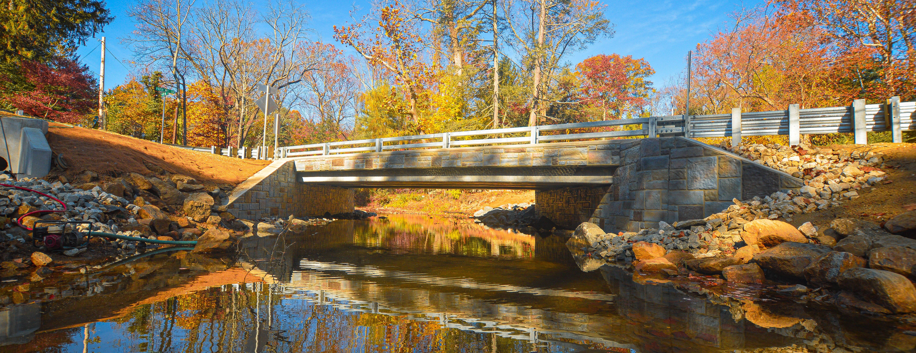



OVERVIEW OF ENVIRONMENTAL REQUIREMENTS
For Project Delivery
FEBRUARY 3, 2026

Slide 2
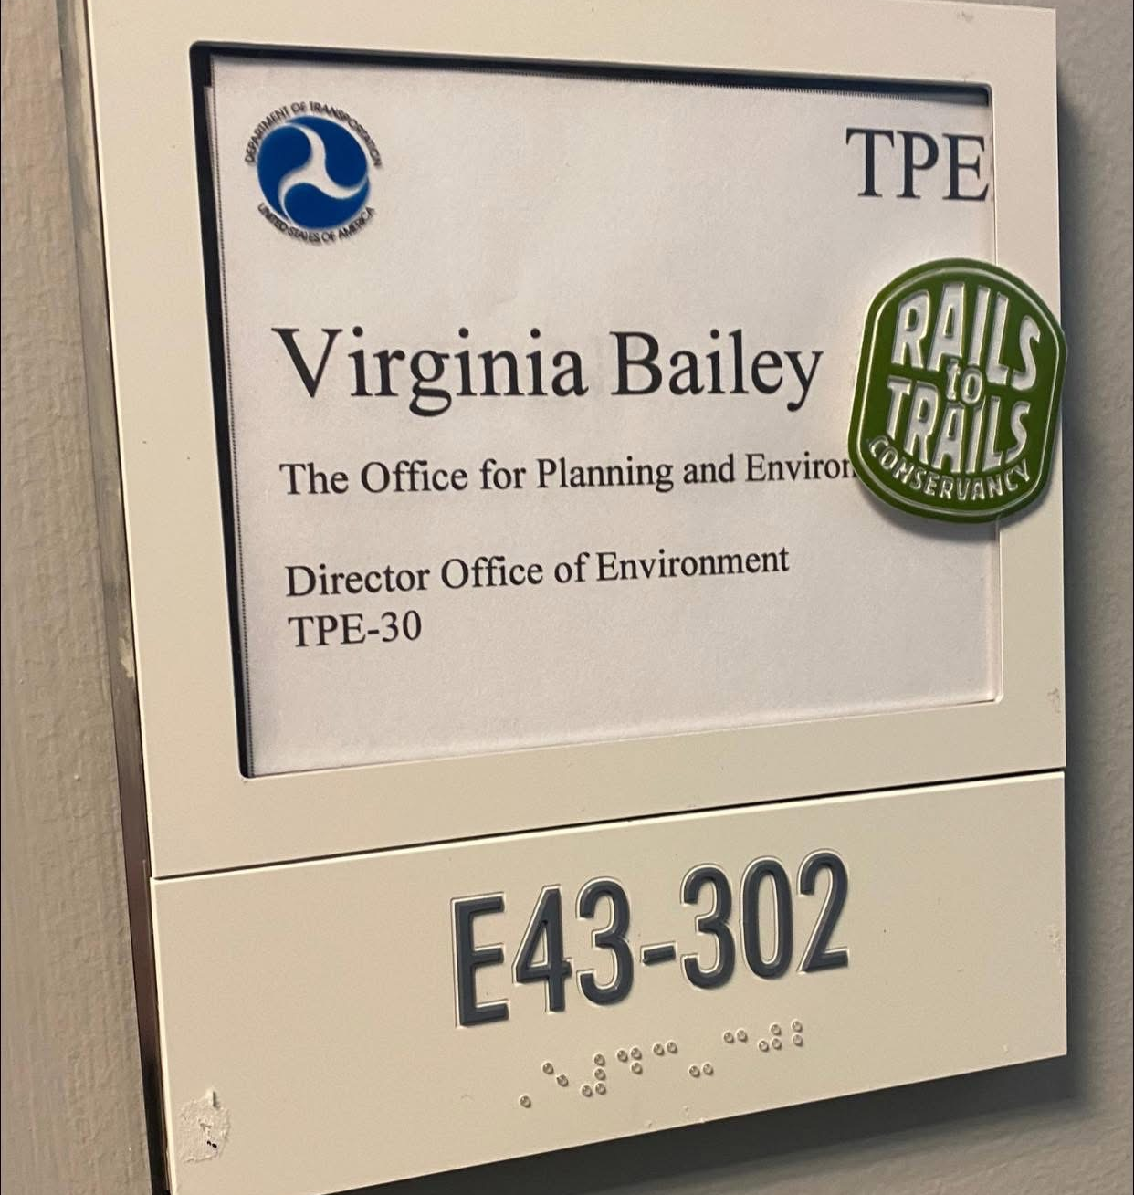



















Virginia Bailey
Assistant Director | NEPA Services Lead
EDUCATION
  B.S. in Environmental Resource Management
  Graduate Certificate in Historic Preservation
CAREER PATH
McCormick Taylor
Nov. 1998 – Jan. 2025
Federal Transit Administration
Jan. 2025 – Feb. 2025
McCormick Taylor
Mar. 2025 - present
EXPERIENCE
  NEPA/Section 4(f)
  Projects of all types/complexities
  Handbook/manual development
  Training
ORGANIZATIONS
CURRENT/PAST CLIENTS

Slide 3
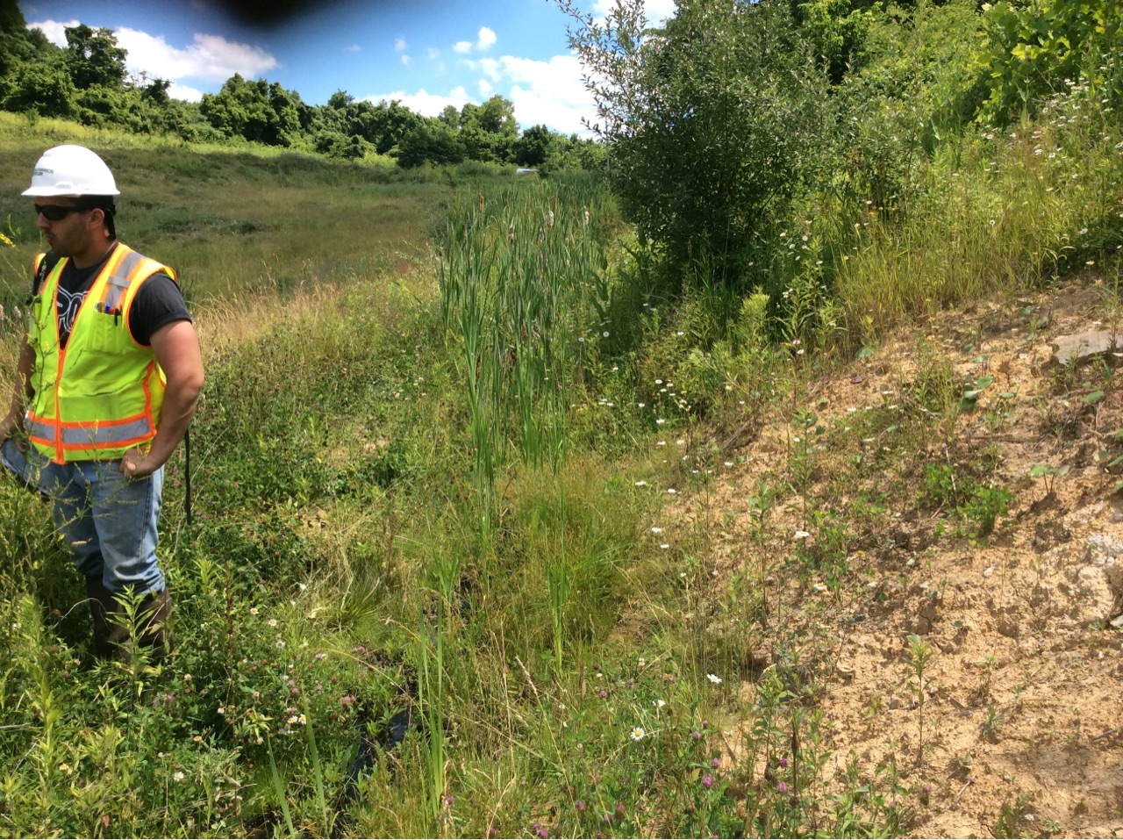
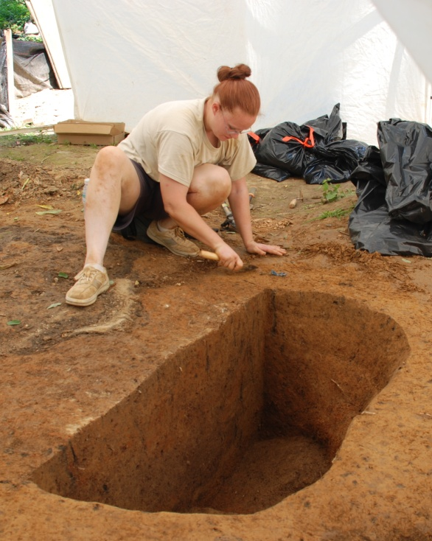
Role of Environmental in Project Delivery
Part of the interdisciplinary team
Keeps project sponsor compliant
Awareness of schedule implications
    Some regulated timeframes
    Outside agency reviews
Reduce rework
Approvals are required before advancing certain project activities

Slide 4
What we will cover:
National Environmental Policy Act (NEPA)
PA Act 120
Cultural Resources
Section 4(f)
Section 6(f) and Other Recreational Grants
Threatened and Endangered Species
Noise
________________________________
Wetlands/Waterways
Agricultural Resources
Community Impacts
Hazardous Waste
Air Quality
Permitting

Slide 5



Declared a national policy to encourage productive and enjoyable harmony between man and the environment to…
National Environmental Policy Act (NEPA)
Passed by Congress in 1969; Signed into Law in 1970
42 U.S.C. §4321 et seq.
Prevent or eliminate damage to the environment
Stimulate the health and welfare of man
Enrich the understanding of ecological systems and natural resources

Slide 6
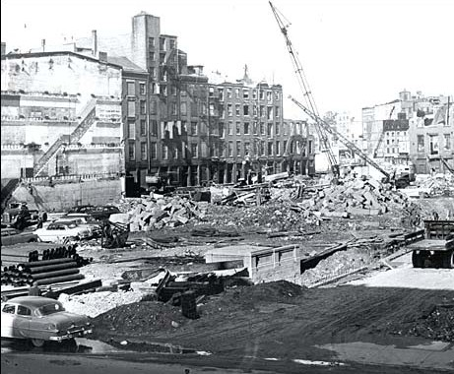
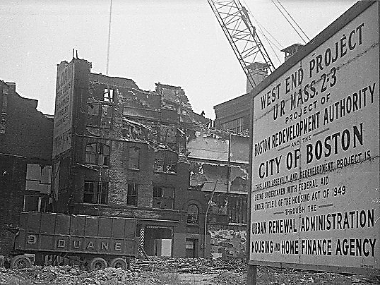
Urban Renewal

Slide 7
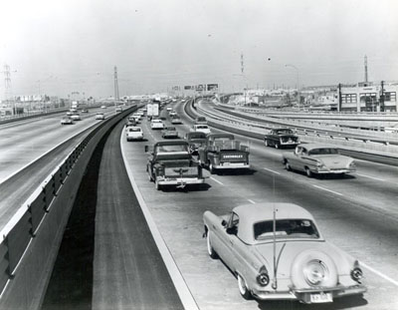
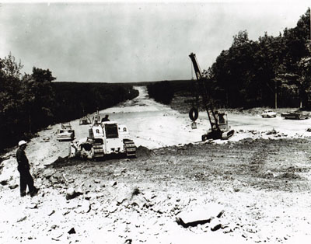
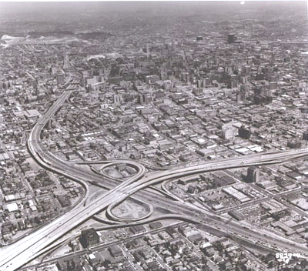
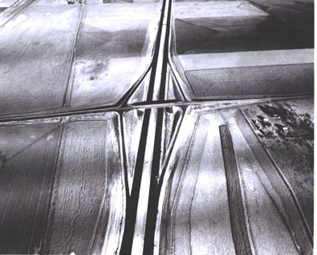
Interstate System

Slide 8
Systematic and interdisciplinary approach
Appropriate consideration to the environment along with economic and technical considerations
Include in proposals, a detailed statement on
Environmental impacts of the action
Adverse impacts that cannot be avoided
Alternatives to proposed action
Consequences of taking proposed action
Agency coordination
Public involvement
NEPA
Decision
Making Framework

Slide 9

NEPA is a procedural law:
Does not direct or require specific decisions
Agencies must take a “hard look” at the environmental consequences of their actions
Agencies must make reasonable findings
Decisions must not be arbitrary and capricious

Slide 10
NEPA Regulations
NEPA created the Council on Environmental Quality (CEQ)
Regulation | Federal Agency
40 CFR 1500-1508 | All Federal Agencies
23 CFR 771 | Federal Highway Administration (FHWA) Federal Transit Administration (FTA) Federal Railroad Administration (FRA)
RESCINDED (2025/2026)

Slide 11

When does NEPA apply?
PA Act 120 of 1970
    Applies to all PennDOT Projects
    Not applicable to the PA Turnpike
    No FHWA funding/other action? Still comply with PA Act 120
    Essentially the state version of NEPA
    Prepare Environmental Documentation (ED) or Environmental Evaluation Report (EER)
“major federal action”
Federal funding
and/or
Required federal approval
    Point of Access Approval
    Federal permit
    Etc.
PennDOT Publication 10B – Design Manual 1B (Post-TIP NEPA Procedures)

Slide 12

The NEPA Umbrella
Title VI of Civil Rights Act of 1964
Uniform Relocation Assistance and Real
Property Acquisition Policies Act of 1970
Americans with Disabilities Act
Section 4(f)
Clean Air Act
Clean Water Act
Executive Order 11988 (Floodplain Management)
Executive Order 11990 (Protection of Wetlands)
Wetlands 23 CFR 777
Endangered Species Act
Farmland Protection Policy Act
Section 6(f) / Land and Water Conservation Funds
Noise 23 CFR 772
National Historic Preservation Act
Economic, Social and Environmental Effects
Public Hearing Requirements 23 USC 128
Archaeological and Historic Preservation Act
Archaeological Resources Protection Act

Slide 13
Essential Elements of NEPA
PURPOSE & NEED
ALTERNATIVES
IMPACTS
MITIGATION
PUBLIC INVOLVEMENT
AGENCY COORDINATION
DOCUMENTATION
PennDOT Publication 10B – Design Manual 1B (Post-TIP NEPA Procedures)

Slide 14
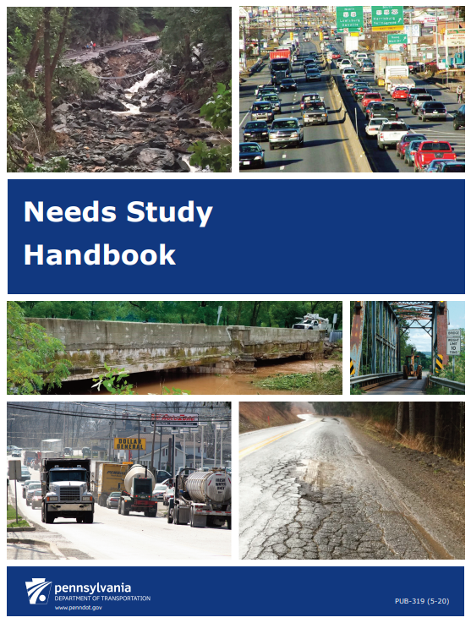
Purpose &
Need
Needs: key problems to be addressed
Tangible and fact-based
Foundation for the purpose statement
Focus on transportation needs
Needs are NOT the solutions!
Purpose: a broad statement of the
overall intended objective to be achieved
by a proposed transportation improvement
PennDOT Publication 319 – Needs Study Handbook

Slide 15
Categories of Potential Needs
CONGESTION
FACILITY DEFICIENCIES
SYSTEM LINKAGES
MODAL INTERRELATION-SHIPS
LEGISLATION
MOBILITY
ECONOMIC DEVELOPMENT
SAFETY*
PennDOT Publication 319 – Needs Study Handbook

Slide 16
Logical Termini
Rational end points for a transportation improvement
Independent Utility
Project must be useable even if no additional transportation improvements in the area are made
Under NEPA, a single project must have:
PennDOT Publication 319 – Needs Study Handbook

Slide 17
Determination of NEPA Class of Action
Proposed Action
Coordination and Analysis
Significant Impact ?
NO
Unknown
YES
Categorical Exclusion (CE)
Environmental
Assessment (EA)
Environmental Impact Statement (EIS)
Significant
impact
  Bridge and Roadway Programmatic Agreement (BRPA)
  CE Level 1a, 1b or 2
PennDOT projects with no Federal oversight
(just Act 120)
Environmental Evaluation Report (EER)
Environmental Documentation (ED) versions of BRPA
and Levels 1a, 1b, and 2
PennDOT Publication 10B – Design Manual 1B (Post-TIP NEPA Procedures)

Slide 18

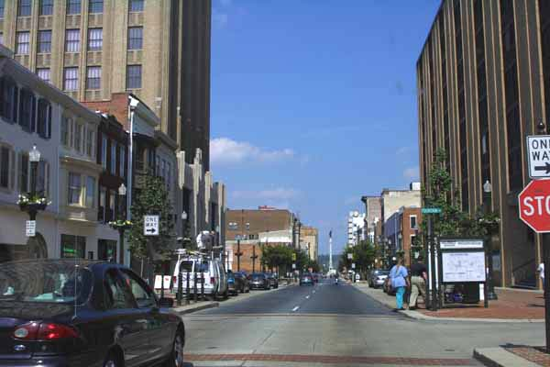


Significance
    CONTEXT
PennDOT Publication 10B – Design Manual 1B (Post-TIP NEPA Procedures)

Slide 19
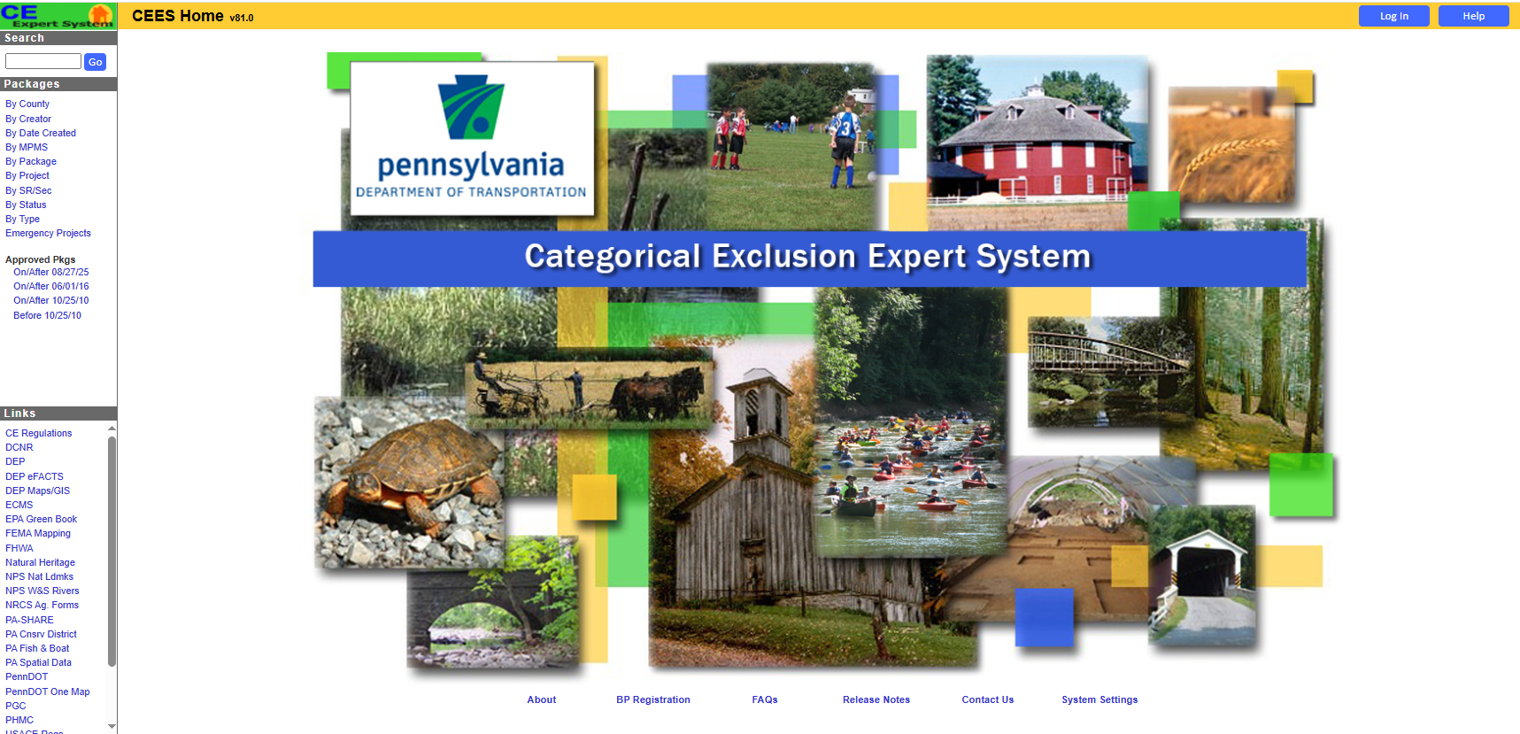
Scoping Documents
For all PennDOT Projects
CEs (federal):
CE BRPAs
CE Level 1a
CE Level 1b
CE Level 2
EDs (non-federal):
ED BRPAs
ED Level 1a
ED Level 1b
ED Level 2
Reevaluations
For CE and ED types
Note: Once approved, all are available in the Approved Package Archive (public)
https://dominoappsbp.penndot.pa.gov/ceea/ceeamain.nsf

Slide 20
Cultural Resources
Section 4(f)
Section 6(f) and Other Recreational Grants
Threatened and Endangered Species
Noise
________________________________
Wetlands/Waterways
Agricultural Resources
Community Impacts
Hazardous Waste
Air Quality
For each:
Law/regulation
Agency with jurisdiction
Associated handbook/guidance
Study/impact area
Points to note

Slide 21
Cultural Resources
National Register of Historic Places (NRHP)
  Listed
  Eligible for Listing
Resource types:
  Sites
  Buildings
  Structures
  Districts
  Objects
Section 106 of the National Historic Preservation Act of 1966
State History Code
State Historic Preservation Office (SHPO)
Consulting Parties
PA-SHARE: https://share.phmc.pa.gov/pashare/landing
PennDOT Publication 689 –
Cultural Resources Handbook

Slide 22
Section 106 Process
Initiate Section 106 Process
Identify Historic Properties
Assess Adverse Effects
Resolve Adverse Effects
Area of Potential Effect (APE)

Slide 23
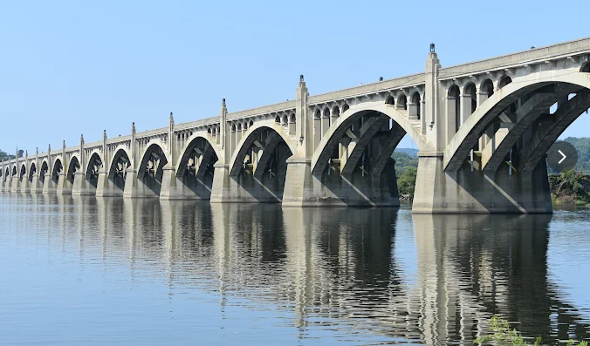

Cultural Resources
Above Ground Historic Resources
APE is defined as the area that could be affected as a result of a project
  Could be visual effects

Slide 24

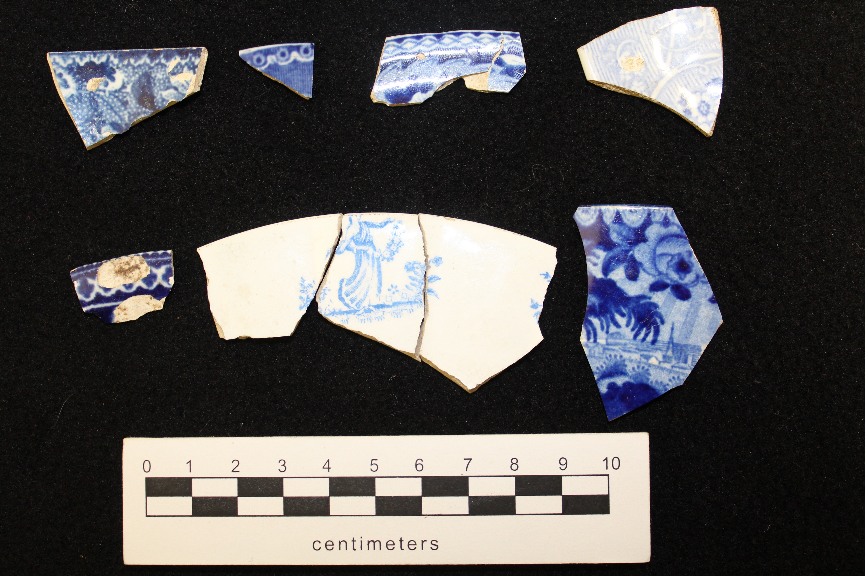
Cultural Resources
Archaeology
Uses LOD as the APE

Slide 25
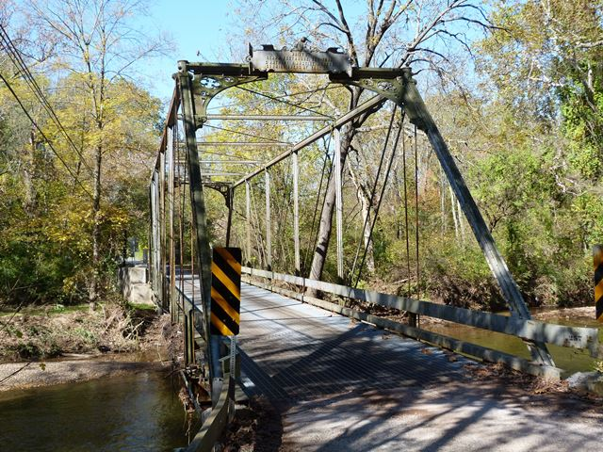

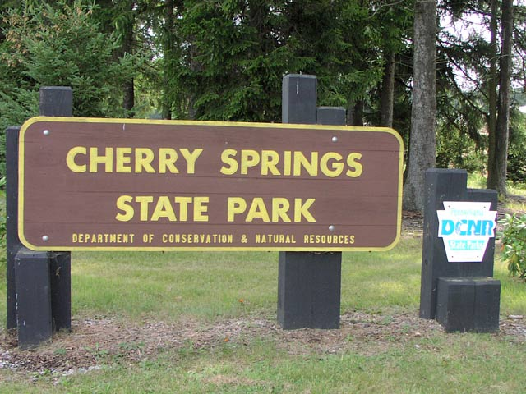
Section 4(f)/Section 2002
U.S. Department of Transportation Act of 1966
Projects with Federal USDOT oversight
Historic properties and Publicly-owned parks, recreation, wildlife/waterfowl refuge areas
Boundary is important
Legal standard – cannot approve “use” unless:
  There is no prudent and feasible alternative to using that land; and
  Project includes all possible planning to minimize harm
  OR
  Use has a de minimis impact
For projects with no federal oversight - Pennsylvania Act 120 of 1970, P.L. 356; Section 2002 of the Administrative Code of 1929
PennDOT Publication 349 – Section 4(f)/ Section 2002 Handbook

Slide 26

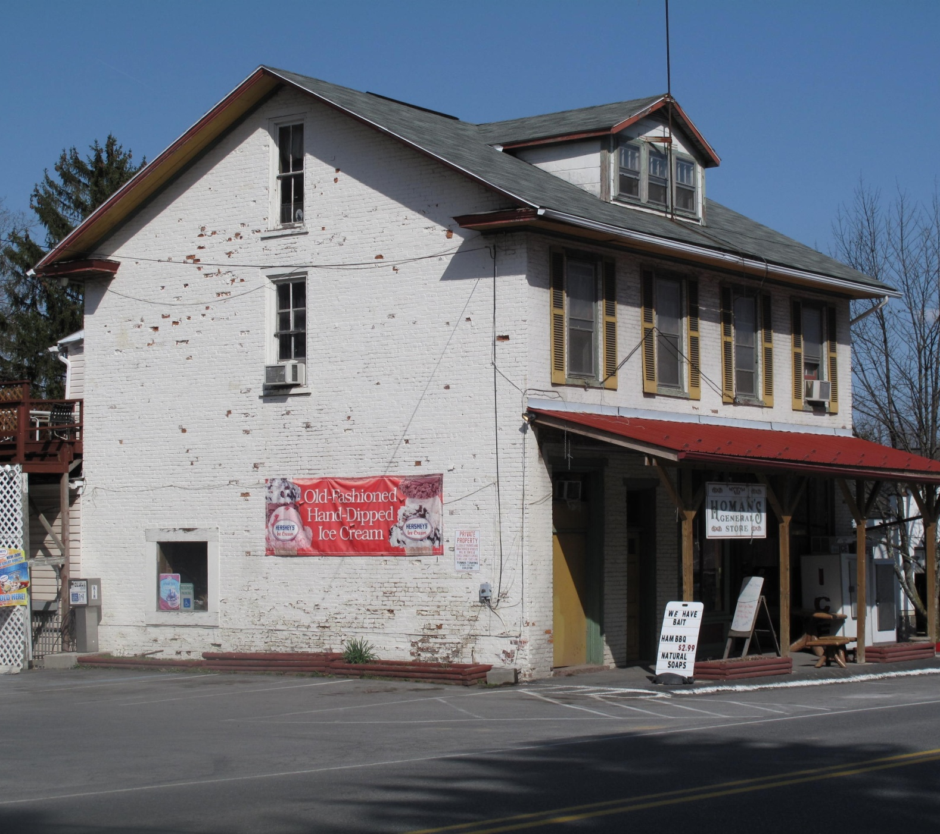

Section 4(f)/Section 2002
PennDOT Forms
  No Use/Non-Applicability
  Temporary Occupancy
  De Minimis
  Use of a Historic Bridge
If adversely affecting a Section 4(f) property (other than a bridge), individual evaluation is required
  Extensive timeline
For projects with no federal oversight - Pennsylvania Act 120 of 1970, P.L. 356; Section 2002 of the Administrative Code of 1929
PennDOT Publication 349 – Section 4(f)/ Section 2002 Handbook

Slide 27

Section 6(f) and State Recreational Grants
Section 6(f) - Land and Water Conservation Fund (LWCF) Act of 1965
  National Park Service (NPS)
    DCNR is the State Liaison Officer (SLO)
  Boundaries are important
  Conversion
  Temporary non-conforming use (>180 days)
  Mitigation
Project 70, Project 500, and other state grant recipients have different procedures/processes
PennDOT Publication 745 – Section 6(f), Project 70, Project 500, and Other Recreational Grant Guidance

Slide 28
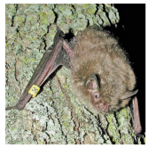
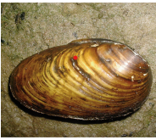
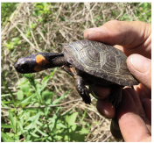
Threatened and Endangered (T&E) Species
Endangered Species Act of 1973
  U.S. Fish and Wildlife Service (USFWS)
  Section 7 – federal agency coordination
  Section 9 – “take”
State laws
  Pennsylvania Fish and Boat Code
  Game and Wildlife Code
  Wild Resource Conservation Act
  Conservation of Pennsylvania Native Wild Plants
    PA Game Commission (PGC)
    PA Fish and Boat Commission (PFBC)
    PA Department of Conservation and
    Natural Resources (DCNR)
IPaC
Information for Planning and Consultation
https://ipac.ecosphere.fws.gov/
PNDI
PA Natural Diversity Inventory
https://conservationexplorer.dcnr.pa.gov/
PennDOT Publication 546 – Threatened and Endangered Species Desk Reference

Slide 29
NEPA in project delivery
For projects with FHWA oversight, NEPA approval is needed before move on to subsequent phases (Final Design, etc.)
When an FHWA authorization (4232) is needed, this will prompt a NEPA reevaluation point if >3 years has passed since NEPA approval or previous reevaluation

Slide 30
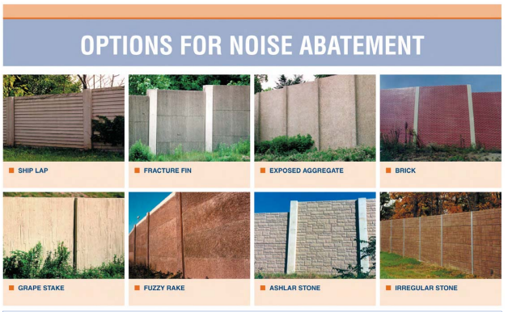
Highway Traffic Noise
FHWA regulations at 23 CFR 772
PennDOT Noise Policy/Handbook
Type I Projects
  Identify Noise Study Areas (NSAs)
    Warranted
    Reasonable
    Feasible
PennDOT Publication 24 – Project Level Highway Traffic Noise Handbook

Slide 31
RESOURCE | JURISDICTIONAL AGENCY | NOTES
Wetlands/Waterways | U.S. Army Corps of Engineers (USACE) PA Department of Environmental Protection (DEP) | Clean Water Act; PA Chapter 105 Impacts trigger permitting requirements
Farmlands | PA Department of Agriculture | Productive Farmland – cannot condemn without ALCAB Hearing
Community Impacts | FHWA/PennDOT | PennDOT has new SOL #430-25-02: Section 2002 Community Impact Project Level Guidance to replace previous Environmental Justice Guidance
Stafford Act Properties | Federal Emergency Management Agency (FEMA) PA Emergency Management Agency (PEMA) | Length process if need ROW from one of these properties
Air Quality | U.S. Environmental Protection Agency PA DEP | Clean Air Act; Typically, a qualitative discussion; depending on project and area could be more extensive of a quantitative analysis

Slide 32

Environmental Commitments and Mitigation Tracking System
(ECMTS)
Need to follow through on NEPA and permitting commitments!

Slide 33
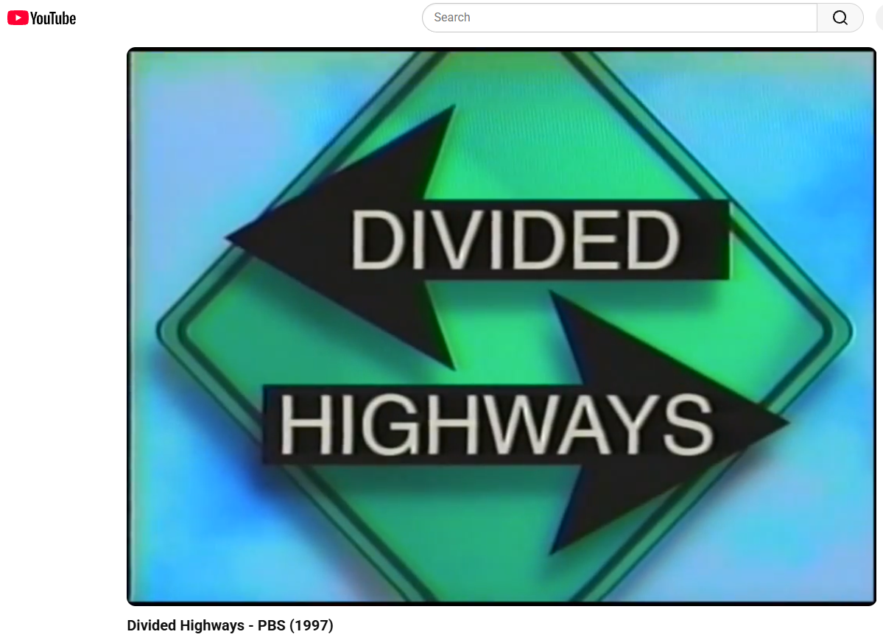
Recommendation!
“Divided Highways”
PBS produced documentary on the history of our roadway system
Available on YouTube:
https://www.youtube.com/watch?v=PLr-8QPbiAY

Slide 34
Useful Links
PennDOT Environmental Webpages: https://www.pa.gov/agencies/penndot/programs-and-doing-business/environment/environmental-policy-and-development
FHWA Environmental Review Toolbox: https://www.environment.fhwa.dot.gov/
PennDOT OneMap (use Planning/Environmental Screening Map): https://gis.penndot.pa.gov/onemap/

Slide 35
PENNDOT NEPA & NEPA UMBRELLA PUBLICATIONS
Pub # | Title
10B | Design Manual 1B/NEPA Procedures
24 | Highway Traffic Noise Handbook
217 | Community Impact Assessment Handbook
295 | Public Involvement Handbook
321 | Air Quality Handbook
319 | Needs Study Handbook
324 | Agricultural Resources Evaluation Handbook
325 | Wetlands Resources Handbook
Pub # | Title
349 | Section 4(f)/Section 2002 Handbook
689 | Cultural Resources Handbook
546 | Threatened and Endangered Species Desk Reference
640 | Indirect and Cumulative Effects Handbook
745 | Section 6(f), Project 70, Project 500, and other Recreation Grant Guidance
783 | Environmental Permitting Handbook

Slide 36


Slide 37


THANK YOU!
Virginia Bailey
Assistant Director NEPA Services Lead
vmbailey@mccormicktaylor.com

