Slide 1
3D Model Delivery with OpenRoads, OpenBridge and Infrastructure Cloud
Keith Gayman, PE
Michael Kuhns, PE

Slide 2
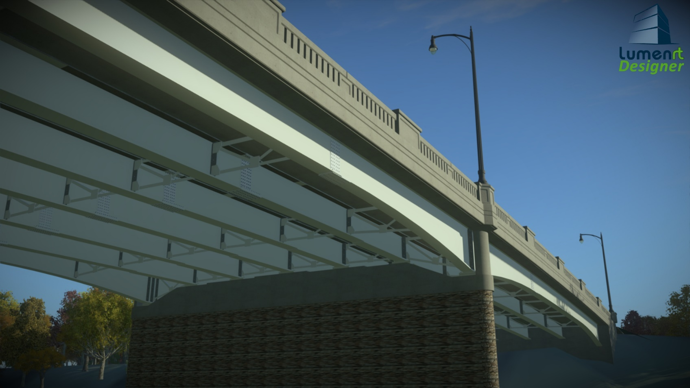
Digital Delivery
Notes:
Speaking Point
Image produced using OBM and Lumen RT software

Slide 3
Digital Delivery
Digital Delivery
  A modernized approach to project delivery processes and contract media that incorporates digital data.
  Construction projects can be bid and built using 3D technology and no longer only be delivered in a traditional construction plan format
  Other related terms:
  BIM – Building Information Modeling
    Use of 3D Models to coordinate different disciplines (e.g., structural and utilities) and to identify/resolve possible clashes between virtual elements prior to actual construction or fabrication.
  BrIM – Bridge Information Modeling
Notes:
Speaking Point
Digital Delivery:
A modernized approach to project delivery processes and contract media that incorporates digital data.
Construction projects can be bid using 3D technology and no longer only be delivered in a traditional construction plan format
Other related terms:
BIM – Building Information Modeling
Use of 3D Models to coordinate different disciplines (e.g., structural and utilities) and to identify/resolve possible clashes between virtual elements prior to actual construction or fabrication.
BrIM – Bridge Information Modeling
Image produced using OBM and Lumen RT software

Slide 4
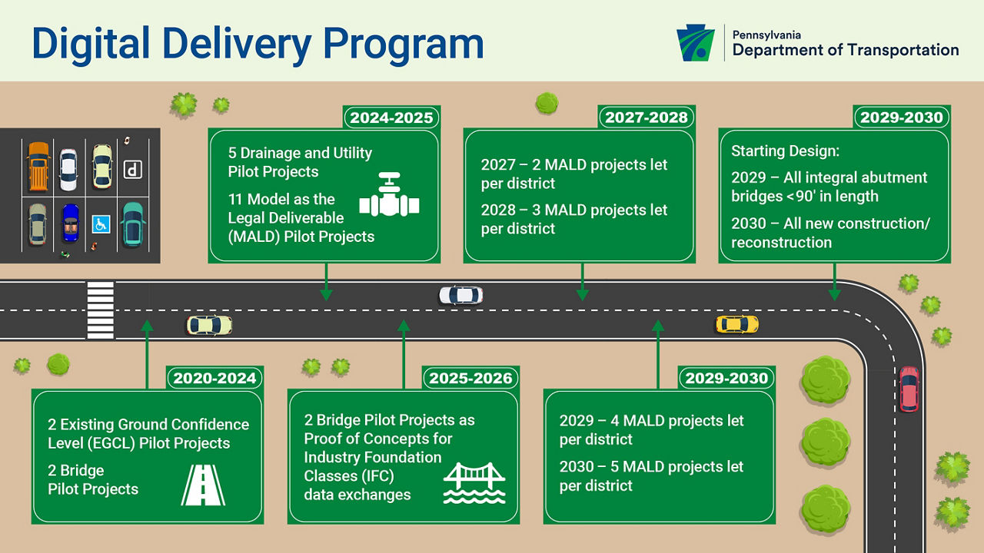
Digital Delivery Directive 2025 Overview
Vision: Starting in 2025, construction projects will be bid using 3D digital technology and no longer be in a traditional construction plan format.
Focus to moving from 2D paper-based deliverables to 3D data-based deliverables
Notes:
Speaking Point
PennDOT Digital Delivery Directive Vision:
By 2025, construction projects will be bid using 3-D technology and no longer be in a traditional construction plan format.
Moving from 2D plan sets to 3D models
2D sheets and reports generated from 3D model

Slide 5
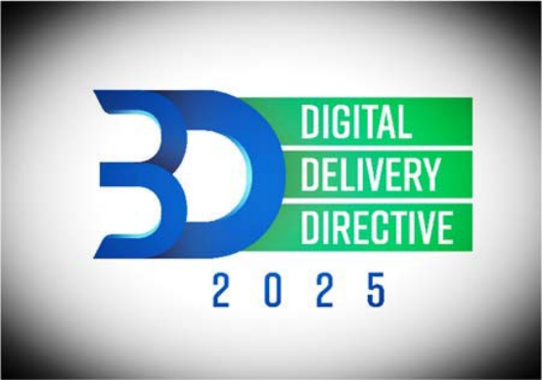
Digital Delivery Directive 2025 Overview
Contractors and construction inspectors will use the digital models on the project site.
The contractor's as‐built deliverable will be an accurate representation of the constructed project.
Notes:
Speaking Point
Contractors and construction inspectors will use the digital models on the project site
The contractor's as‐built deliverable will be an accurate representation of the constructed project
Feedback from Contractors
Really like “Saved Views”
Guys tying rebars given hard copies of Saved Views
Inspectors like using the Locate Button to pinpoint where they are within the model

Slide 6
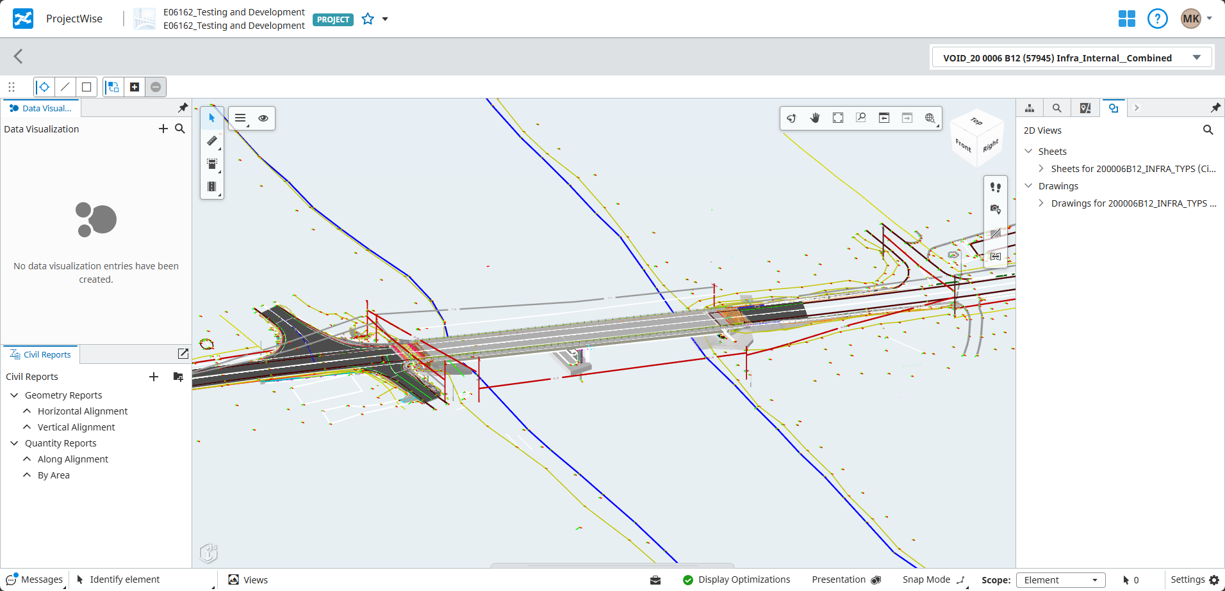
Model-Centric Workflow
3D model as the central repository of digital data that grows with the progression throughout project phases and is used as the basis for required content and deliverables
Notes:
Speaking Point
Model-Centric Workflow
Model is the central repository of data
It grows through project development
Forms the basis for the required content and the Deliverable
Model is main part of Deliverable
Even for traditional Deliverable methods, models can be used to create needed delivery requirements

Slide 7
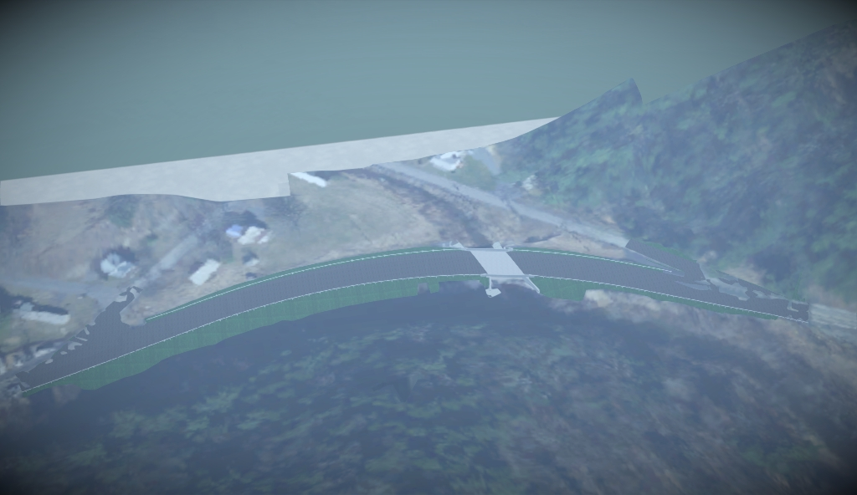
OpenRoads Designer
Notes:
Speaking Point
Image produced using OBM and Lumen RT software

Slide 8
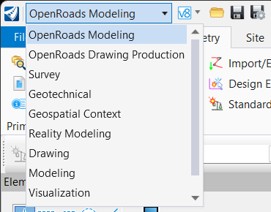
OpenRoads Modeler - Workflows
Numerous workflows present in ORD
OpenRoad Modeler workflow is used to generate Geometry, Corridors, and Superelevation
Modeling workflow follows the recommended steps to create your 3D model
Notes:
Speaking Point
Numerous workflows present in ORD
Modeling workflow is used to create 3D model
Drawing and Drawing Production workflows are used during plan creation and for annotations

Slide 9
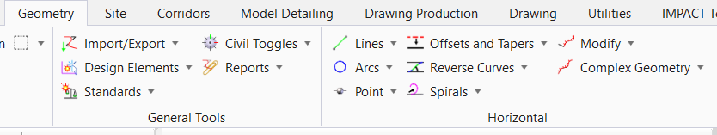
OpenRoads Geometry - Horizontal
Geometry Tab is used to create Horizontal and Vertical Alignments
The Offsets and Taper tools are extremely powerful when used with Feature Defintions
Horizontal and Offset Geometry tools should be used in lieu of Smartline or Line tools
Persist Snap tool on the Feature Definition toolbar is used to create smart Geometry
Notes:
Speaking Point
Geometry Tab should be used for all Alignment and Linework creation
Offset and Tapers should be used when needing to follow any Horizontal Geometry
Smart Geometry allows for a Parent child relationship, This means if you use the offset tool to create linework that linework remembers how it was created and will hold the station and offset of when it was created even if the parent element moves.

Slide 10
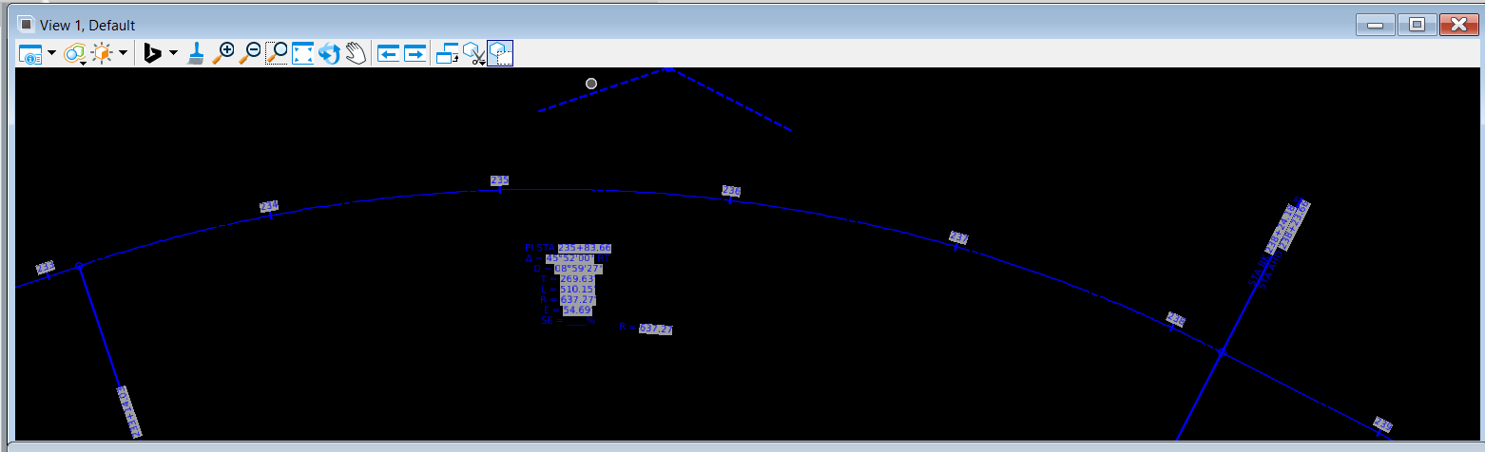
OpenRoads Geometry - Horizontal
Annotation can be displayed in any file whether they are the active file or not
Notes:
Speaking Point
Annotations are assigned based on the Feature Definition of the Element
These annotations are dynamic and with change the values if the element changes

Slide 11
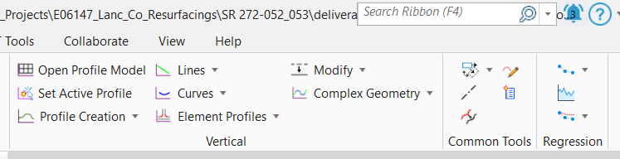
OpenRoads Geometry - Vertical
Vertical Alignments can be applied to any Geometry (Horizontal Linework or Offsets)
Profiles can be created from an Existing Surface, Slopes, and Vertical offsets
Multiple Verticals can be used on a single Geometry
Notes:
Speaking Point
Multiple Verticals can be assigned to a single Geometry and can be switched between each using the active profile
Having multiple profiles allows for testing different profiles to easily consider different alternatives

Slide 12
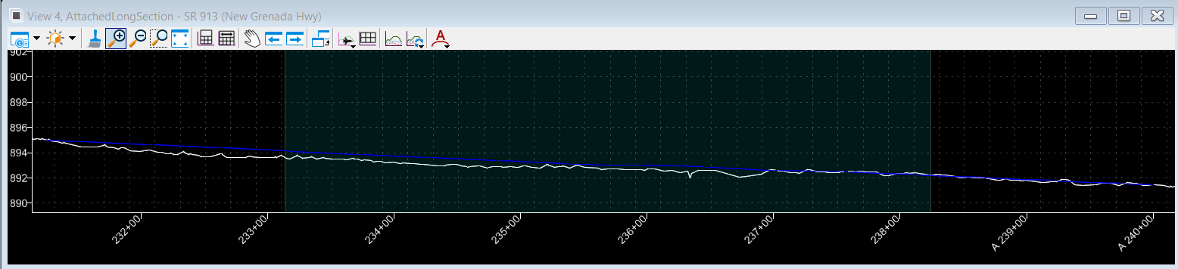
OpenRoads Geometry - Vertical
Vertical Annotation can only be displayed inside of the Alignment file where the Vertical Alignment resides
Notes:
Speaking Point

Slide 13
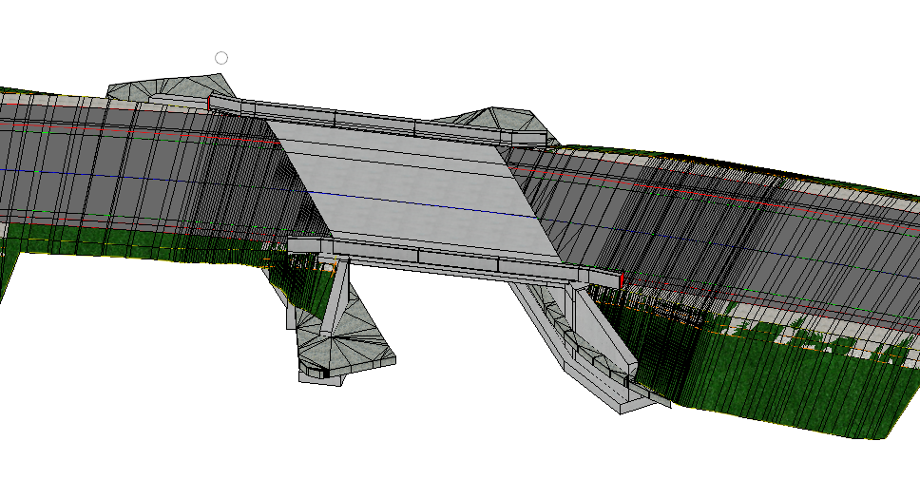
OpenRoads Corridors
Corridors are not just used for Roads
You can use corridors for Ditches and Ponds
Corridors can be assigned Elements other that Roadway CLs as well as having multiple Corridors in on file
Superelevation can also be generated automatically based on your design speed and Max e%
Notes:
Speaking Point
The corridors within ORD operate similarly to Inroads using a Template library
Corridor can be built upon other Corridors. (example is having a Roadway template with just lanes and shoulder and then end condition corridor attached to the Roadway. This allows for lots of end condition templates without having multiple roadway templates.)

Slide 14
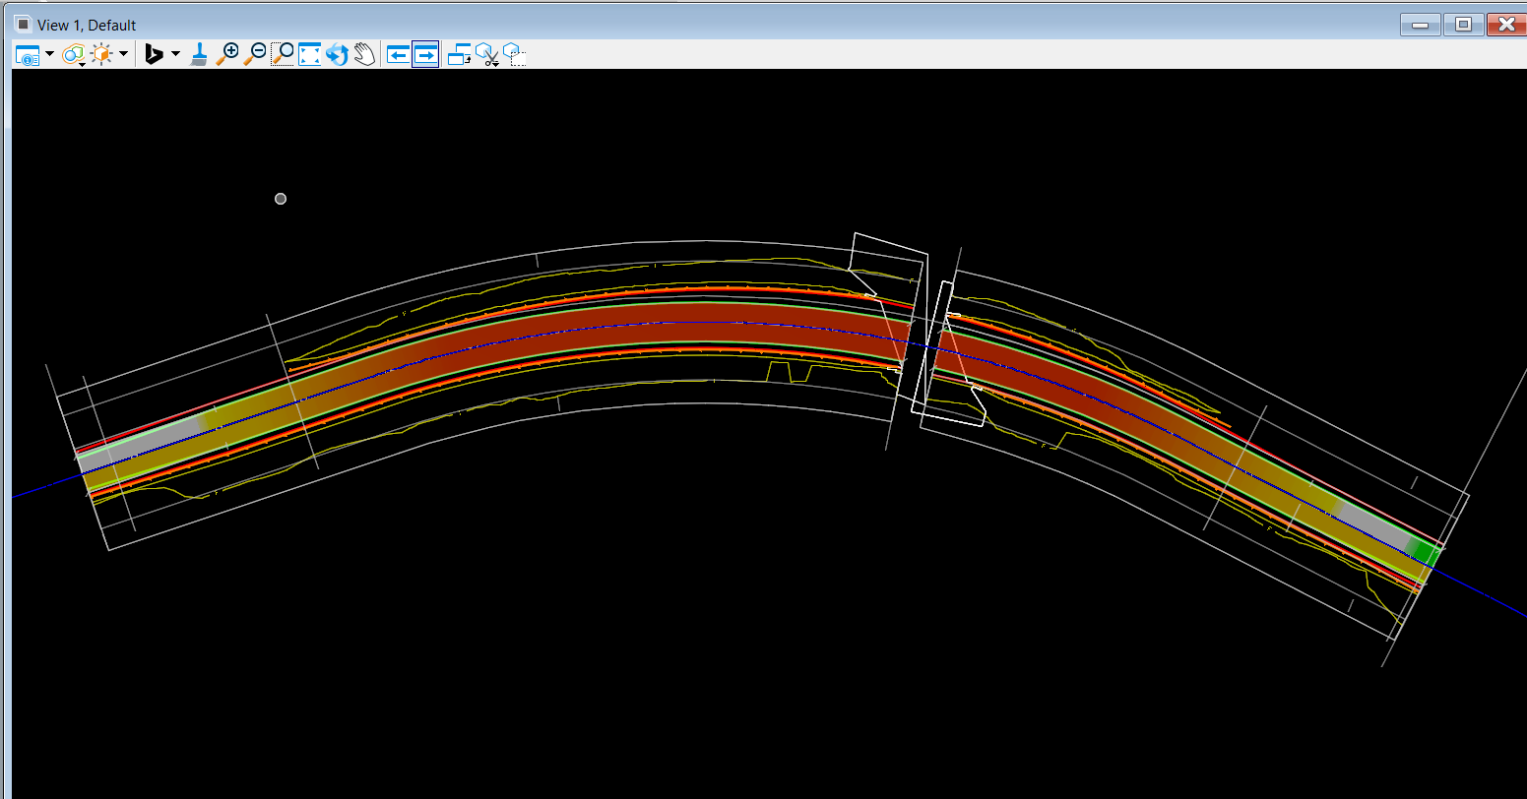
OpenRoads Corridors
Notes:
Speaking Point
The corridors within ORD operate similarly to Inroads using a Template library
Corridor can be built upon other Corridors. (example is having a Roadway template with just lanes and shoulder and then end condition corridor attached to the Roadway. This allows for lots of end condition templates without having multiple roadway templates.)

Slide 15
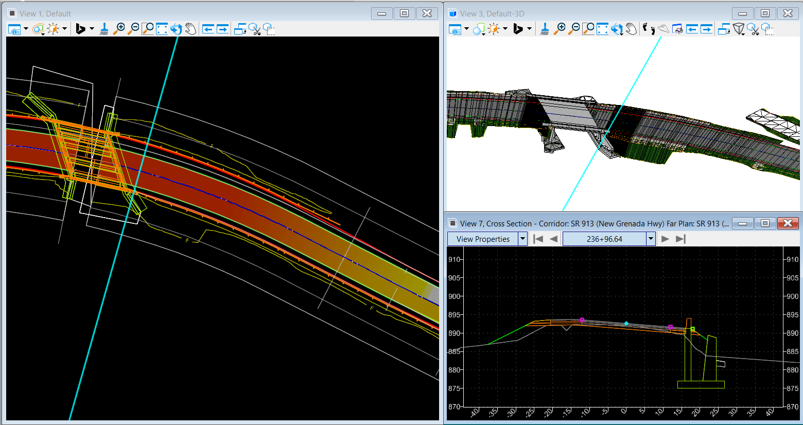
OpenRoads Corridors
Notes:
Speaking Point

Slide 16
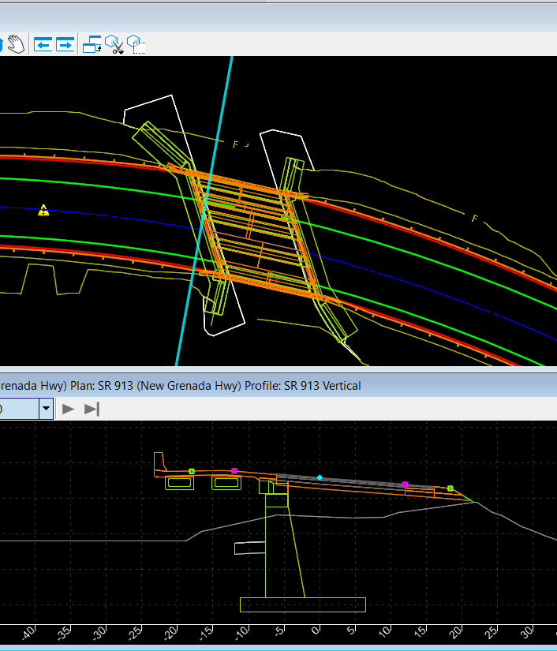
OpenRoads Corridors – Dynamic Sections
Cross Sections can be viewed at any Station not just where sections are cut
This ability allows for more design refinement and clean up
Notes:
Speaking Point

Slide 17
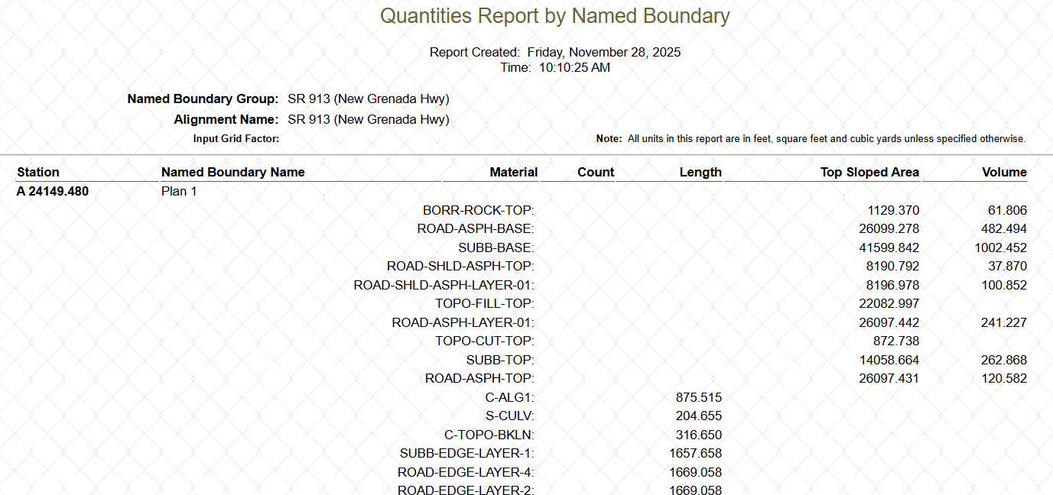
OpenRoads Reports
If you build your 3D model with Smart Geometry, Feature definitions, and Corridors you can auto Generate reports with accurate quantities
Notes:
Speaking Point
Also in development is the ability to assign the PennDOT Standard item number to the components to make quantities even easy to manage with different pavement layers or rock sizes

Slide 18
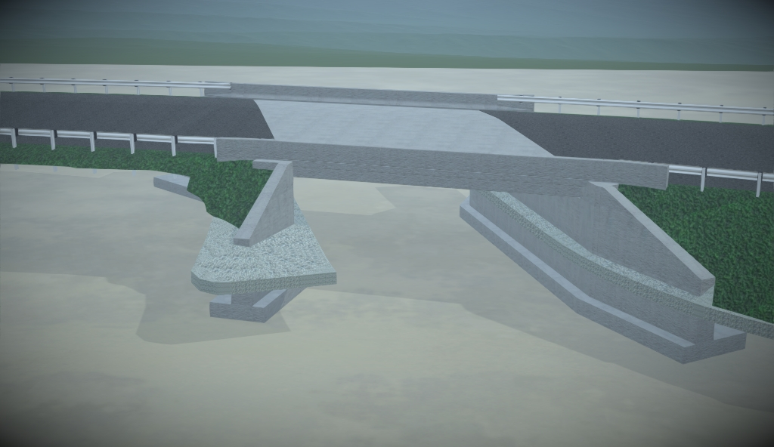
OpenRoads – Lumen RT
Once your corridors are built you can use Lumen RT visualization software to create High-Res images for displays and presentations
Notes:
Speaking Point

Slide 19
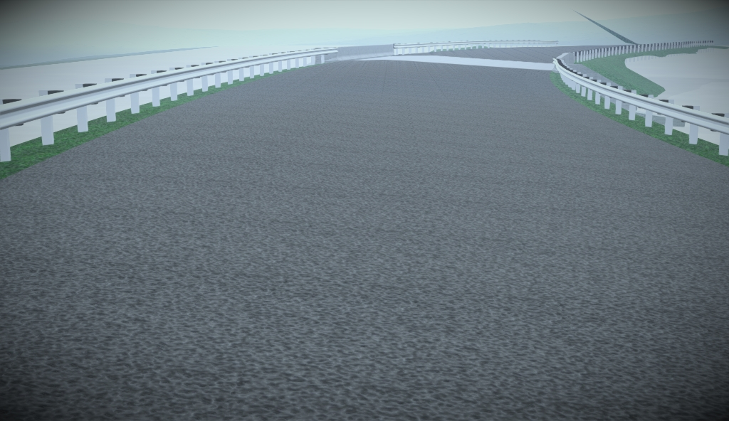
OpenRoads – Lumen RT
Notes:
Speaking Point

Slide 20
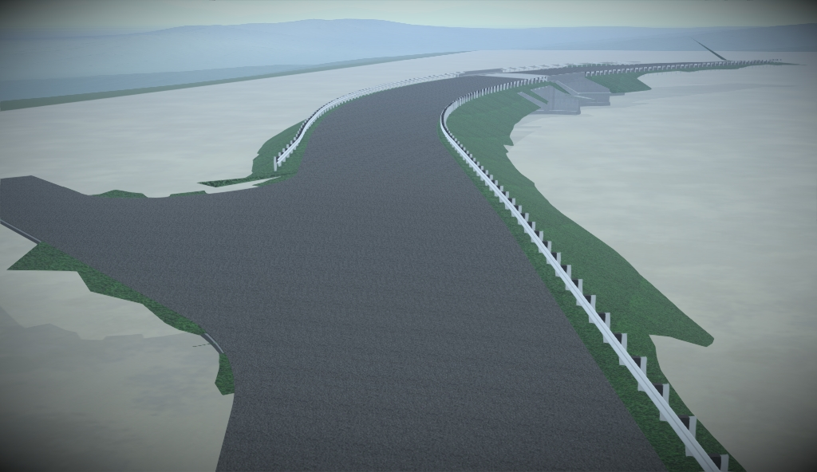
OpenRoads – Lumen RT
Notes:
Speaking Point

Slide 21
OpenBridge Designer
Notes:
Speaking Point
Image produced using OBM and Lumen RT software

Slide 22
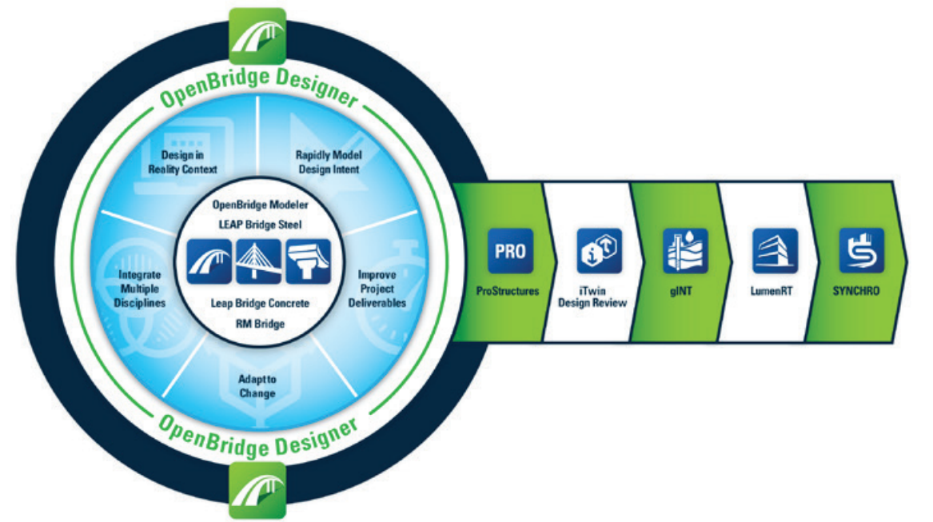


OpenBridge Designer
OBD consolidates multiple Bentley software programs (.obdx)
  OpenBridge Modeler (.dgn)
  LEAP Bridge Concrete (LBC) (contained within .obdx file)
  LEAP Bridge Steel (LBS) (contained within .obdx file)
Notes:
Speaking Point
OBD consolidates multiple Bentley software programs (.obdx)
OpenBridge Modeler (.dgn)
LEAP Bridge Concrete (LBC) (contained within .obdx file)
LEAP Bridge Steel (LBS) (contained within .obdx file)
OBD consolidates multiple Bentley software programs including OpenBridge Modeler and Bentley structural analysis software such as LEAP Bridge Concrete (LBC) and LEAP Bridge Steel (LBS) as well as software for other functions
OBM software can be accessed currently as a separate software or, as the workflow outlined in this manual follows, through OBD

Slide 23
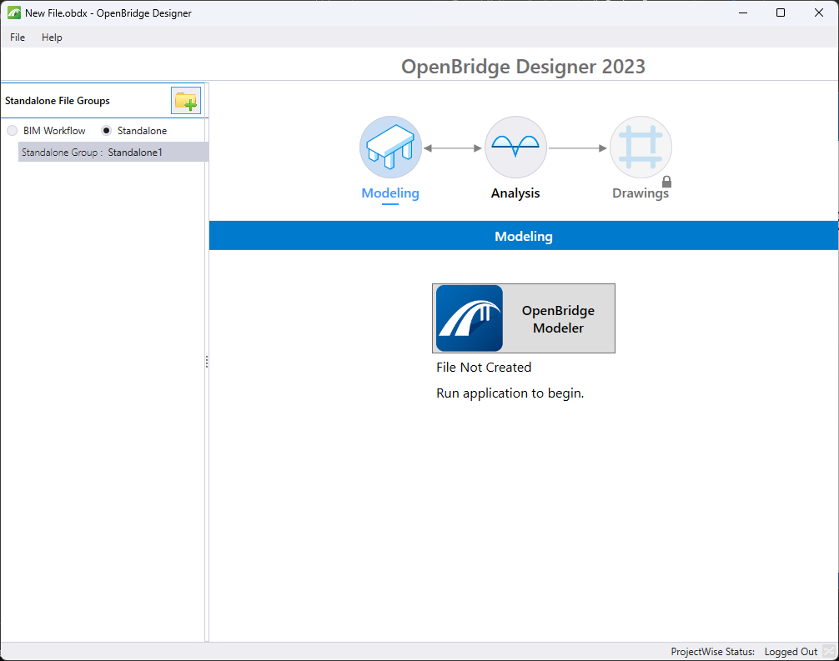
OpenBridge Designer - Modeling
Multiple projects can be contained within one OBDX file
OBM files created in one OBD file can be opened in another OBD file
Notes:
Speaking Point

Slide 24
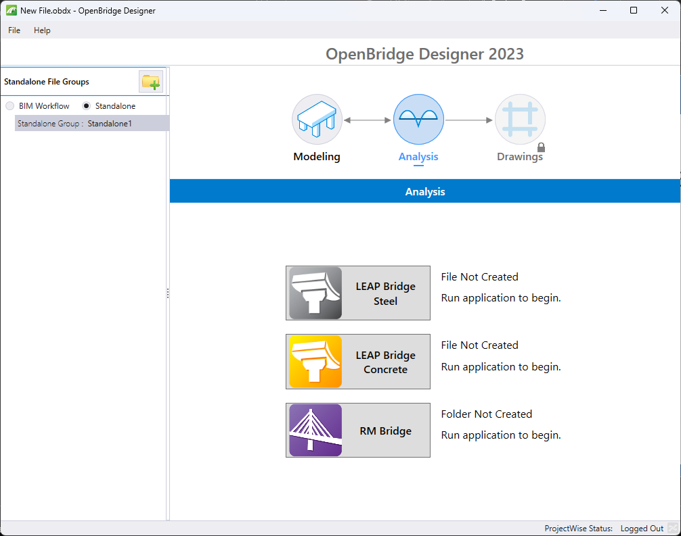
OpenBridge Designer - Analysis
Bentley Analysis Programs LEAP Bridge Concrete (LBC), LEAP Bridge Steel (LBS), and RM Bridge all accessible as standalone analysis options.
Interoperability between OpenBridge models and Bentley analysis software is accessible from within OBM.
Notes:
Speaking Point

Slide 25
OpenBridge Modeler
Notes:
Speaking Point
Image produced using OBM and Lumen RT software

Slide 26
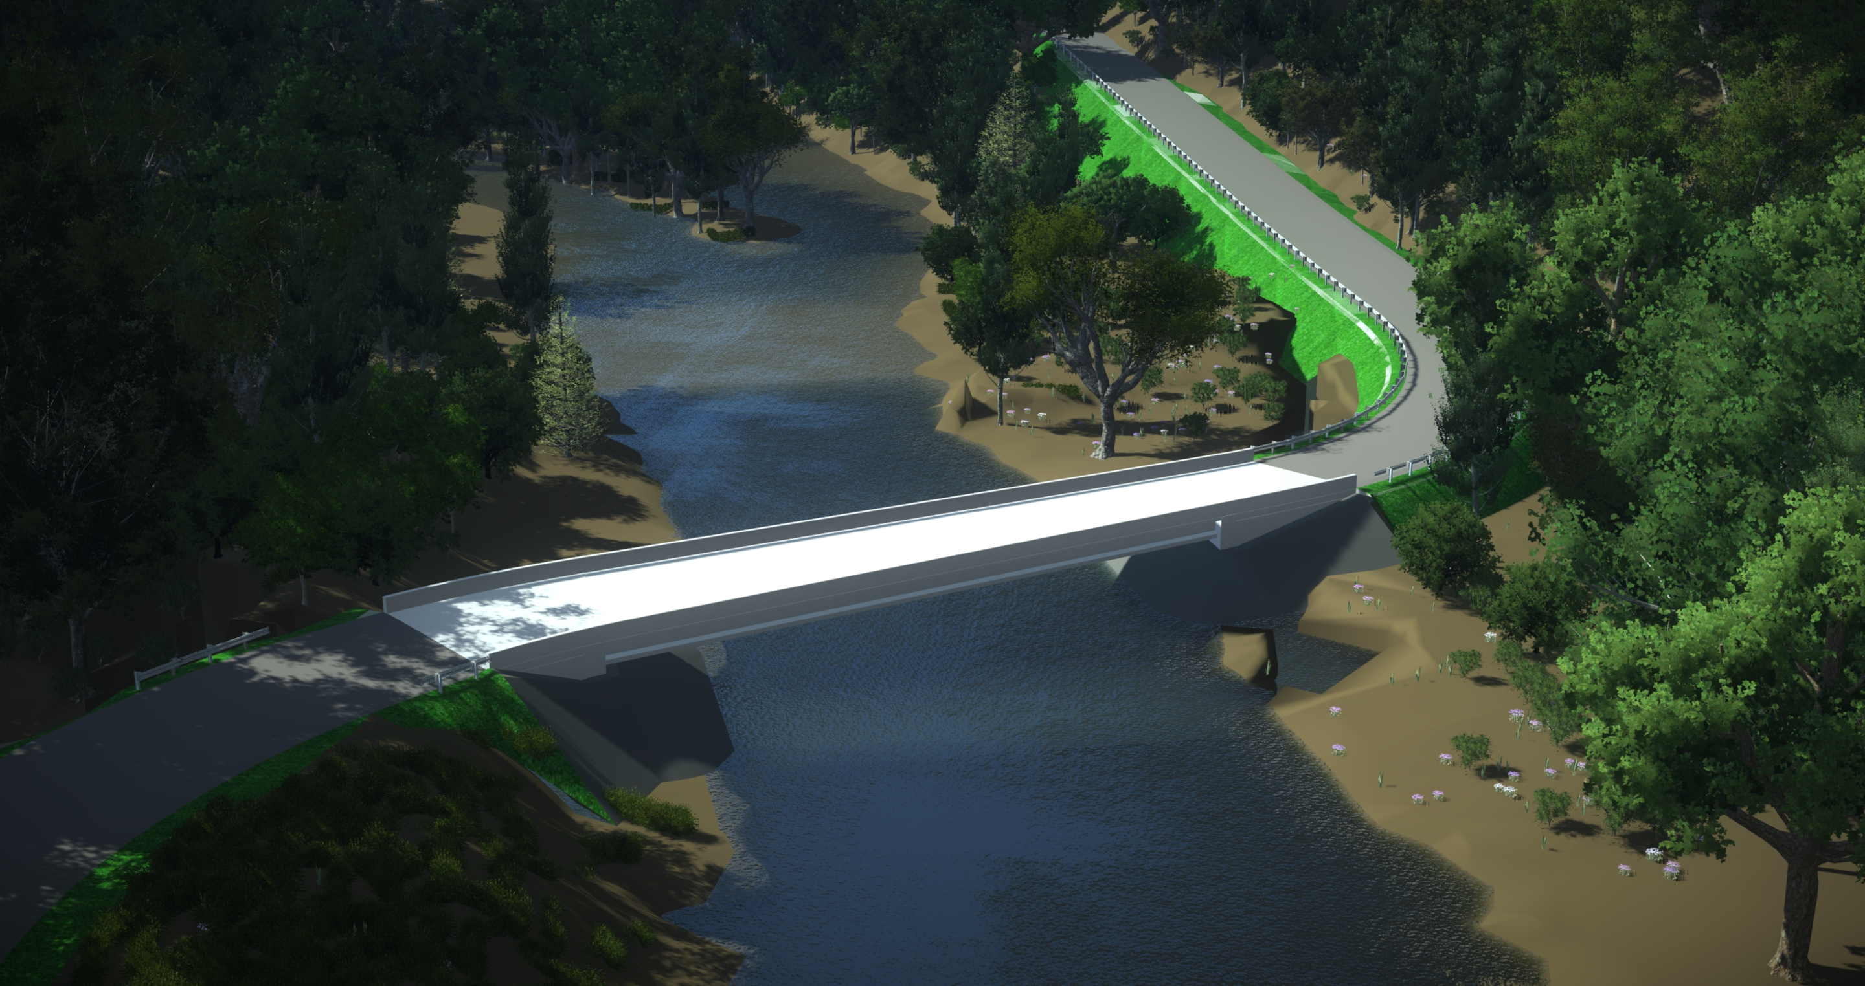
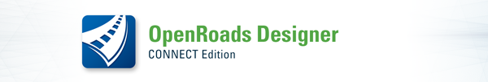
OpenBridge and OpenRoads
View and interact with the road and bridge designs together
Automatic change with 3D design enables designers to test "what if?" scenarios
Refine constructability and optimize project efficiency
Notes:
Speaking Point
View the road and bridge designs together
Interoperability between OpenRoads and OpenBridge
Automatic change with 3-D design enables designers to test "what if?" scenarios and evaluate alternatives
Quickly run quantities reports for alternatives
Refine constructability and optimize project cost

Slide 27
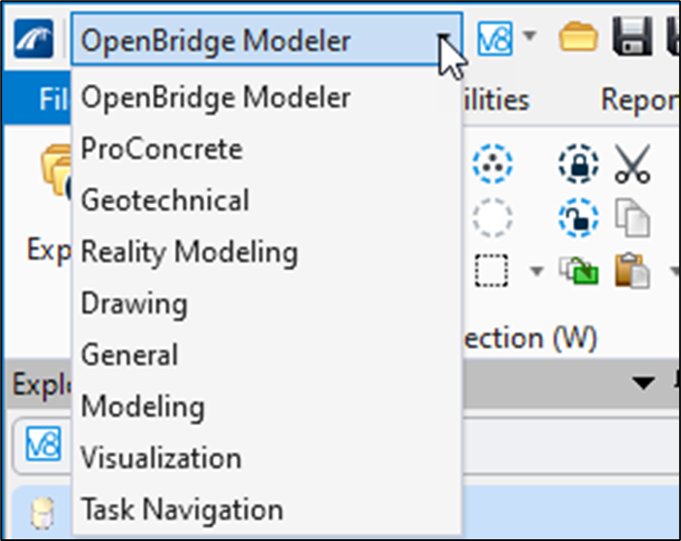
OpenBridge Modeler - Workflows
Numerous workflows present in OBM
OpenBridge Modeler workflow used to generate Base Model
Modeling workflow used to advance Base Model to Refined Model
Notes:
Speaking Point
Numerous workflows present in OBM
OpenBridge Modeler workflow used to generate Base Model
Modeling workflow used to advance Base Model to Refined Model
Drawing workflow is used to cut section, add dimensions and other MicroStation tools available
It is not uncommon for the user to have to switch between workflows to find tools needed for modeling

Slide 28

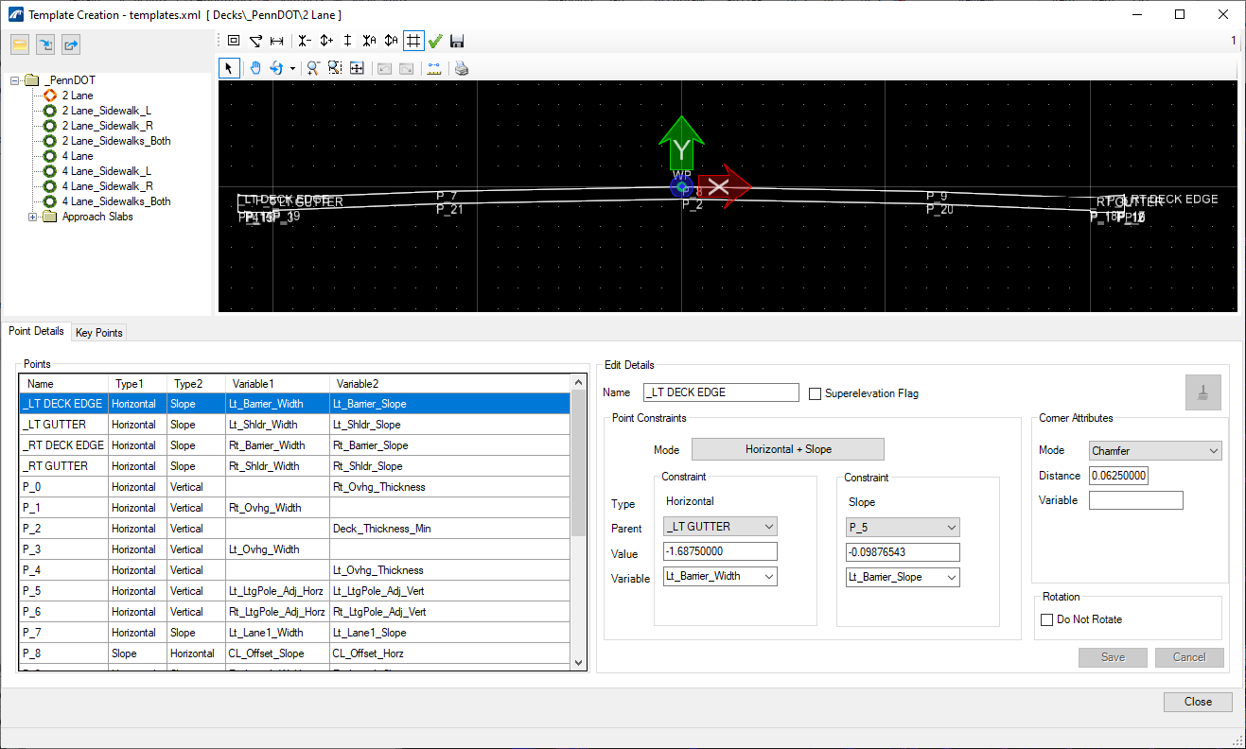
OBM Workspace Templates
Templates provided in PennDOT OBM Workspace
  Decks
  Barriers
  Beams
  Abutments
  Wingwalls
  Piers
  Cross Frames
  Stiffeners
Notes:
Speaking Point
PennDOT specific templates
Used in the Intro Course for Base Modeling
Can be modified

Slide 29
Definitions
Model Element
  An entity within a model that represents a physical object or an abstract concept
Component
  A physical item or feature within a model
Parametric
  Representing digital information for a model component by parameters
  This is usually referring to geometric data which can be linked to related components through internal logic
Notes:
Speaking Point
Model Element
An entity within a model that represents a physical object or an abstract concept (i.e. an abutment stem, north arrow)
Component
A physical item or feature within a model – Used to describe typical “components” or sub-components of the bridge (i.e. deck, barriers, piers, etc.)
Parametric
Representing digital information for a model component by parameters
This is usually referring to geometric data which can be linked to related components through internal logic
Definitions are present in “USER'S GUIDE FOR MODEL-CENTRIC WORKFLOW USING BENTLEY’S OPENBRIDGE DESIGNER” section 1.7.

Slide 30
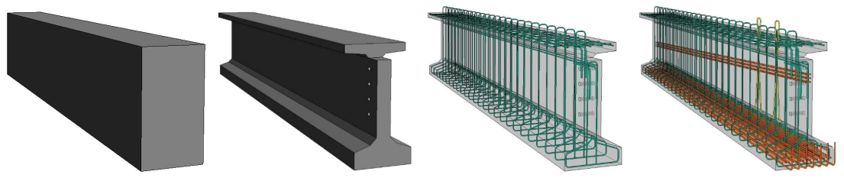
Definitions
Level of Development (LOD)
  A qualitative designation that communicates the degree of engineering intent behind a 3D model element (or group of model elements) and defines the authorized uses for which the model element is sufficiently developed.
  Normally the LOD will increase through the design development process.
Source: FHWA
Notes:
Speaking Point
Level of Development
A qualitative designation that communicates the degree of engineering intent behind a 3D model element (or group of model elements) and defines the authorized uses for which the model element is sufficiently developed
Normally the LOD will increase through the design development process

Slide 31
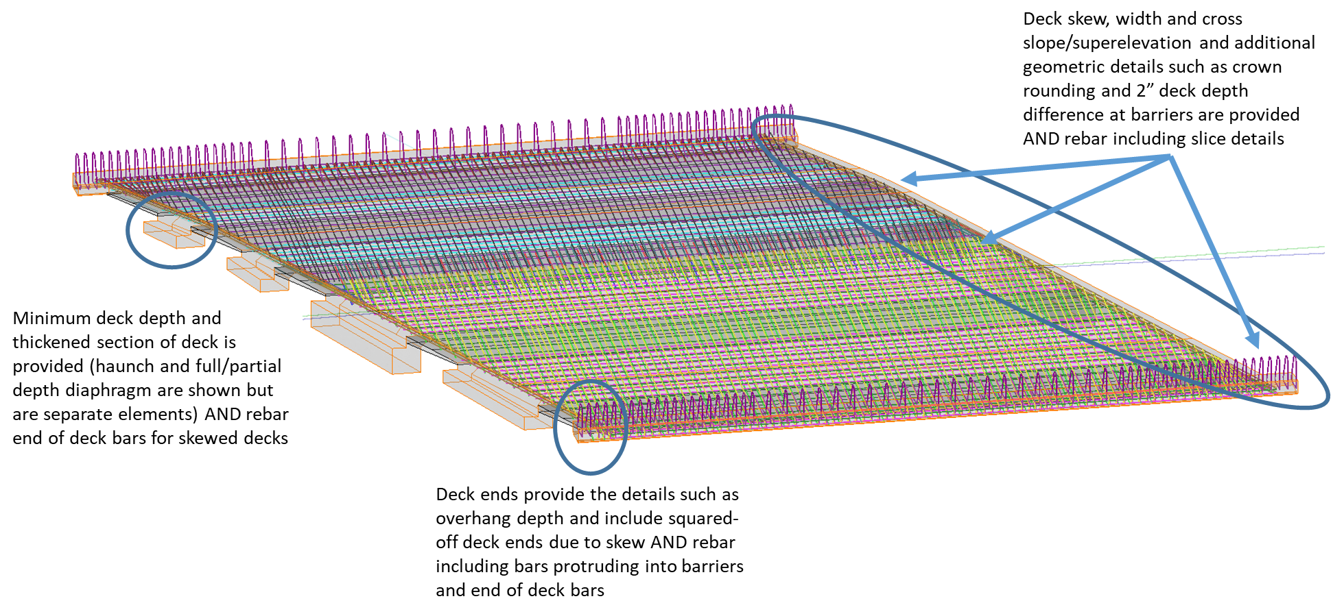
Definitions
Level of Detail
  Describes only the amount of geometric detail in a model element, not the amount of engineering intent.
  PennDOT will use Element Detail Designation (EDD) for definition in models.
Notes:
Speaking Point
Level of Detail
Describes only the amount of geometric detail in a model element, not the amount of engineering intent
Highly detailed model elements may be placed in a model as placeholders with no engineering intent
Though detail often increases in parallel with development, observing the detail of a model element is not an effective way to determine its development or appropriate uses.
PennDOT will use Element Detail Designation (EDD) for definition in models
Definitions are present in “USER'S GUIDE FOR MODEL-CENTRIC WORKFLOW USING BENTLEY’S OPENBRIDGE DESIGNER” section 1.7.

Slide 32
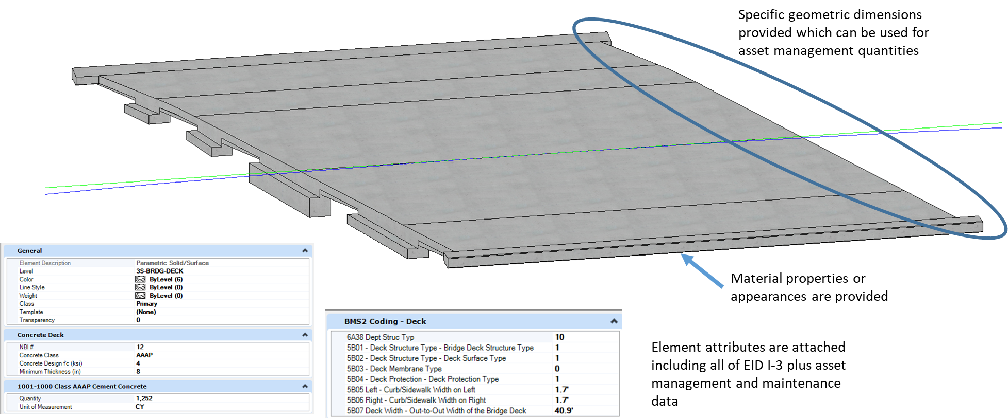
Definitions
Level of Information
  A description of the completeness and quality of the non-graphical information attached to the model elements.
  PennDOT will use Element Information Designation (EID) for definition in models.
Notes:
Speaking Point
Level of Information
A description of the completeness and quality of the non-graphical information attached to the model elements
Communicates the reliability of measurements and quantities to meet construction specifications
Additional information such as material properties, manufacturers details, and other data for asset management
PennDOT will use Element Information Designation (EID) for definition in models
Definitions are present in “USER'S GUIDE FOR MODEL-CENTRIC WORKFLOW USING BENTLEY’S OPENBRIDGE DESIGNER” section 1.7.

Slide 33
Definitions
Base Model
  Takes advantage of the current software capabilities as much as possible.
  Advantageous for elements to remain in the “Base” status for as long as possible throughout the design process.
Refined Model
  When the Level of Detail or information needed for the general design process, or a specific submission exceeds that which can be provided as a “Base” element.
Notes:
Speaking Point
Base Model
Takes advantage of the current software capabilities as much as possible
Advantageous for elements to remain in the “Base” status for as long as possible throughout the design process
Refined Model
When the Level of Detail or information needed for the general design process, or a specific submission exceeds that which can be provided as a “Base” element
Definitions are present in “USER'S GUIDE FOR MODEL-CENTRIC WORKFLOW USING BENTLEY’S OPENBRIDGE DESIGNER” section 1.7.

Slide 34
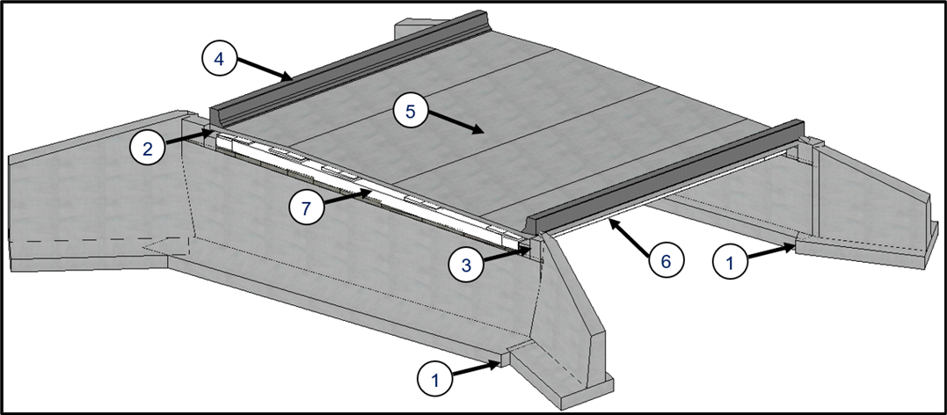
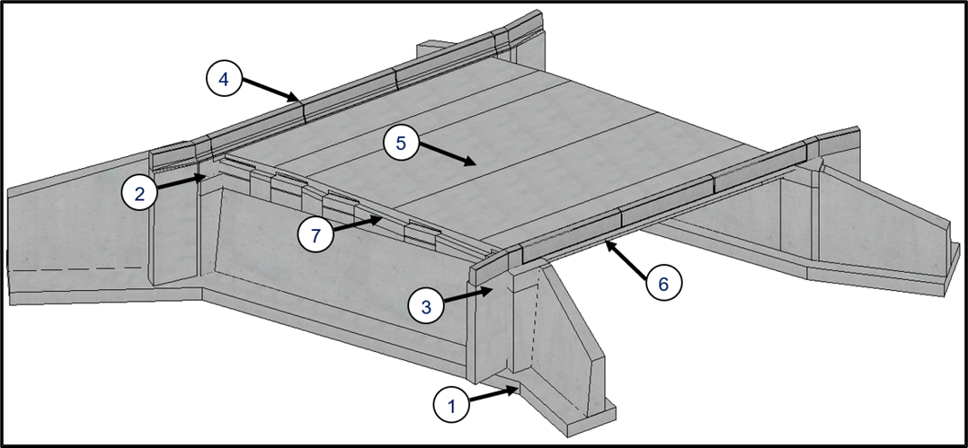
Definitions
Base Model
Refined Model
Notes:
Speaking Point
Base Model
Takes advantage of the current software capabilities as much as possible
Advantageous for elements to remain in the “Base” status for as long as possible throughout the design process
Refined Model
When the Level of Detail or information needed for the general design process, or a specific submission exceeds that which can be provided as a “Base” element
Definitions are present in “USER'S GUIDE FOR MODEL-CENTRIC WORKFLOW USING BENTLEY’S OPENBRIDGE DESIGNER” section 1.7.

Slide 35
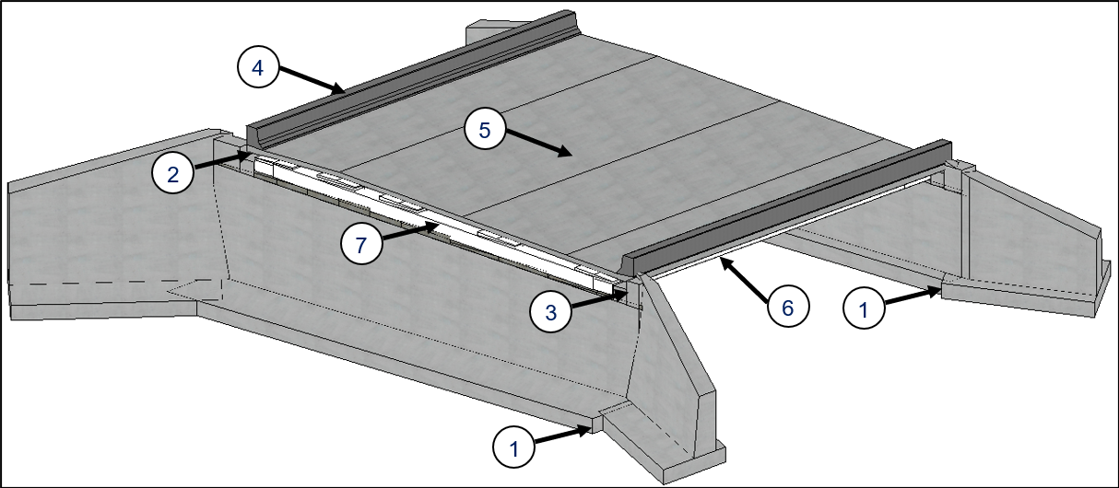
Base Model
Notes:
Speaking Point
Example:
No. 2 – Bentley added a Deck Breakback tool to square off deck corners for skewed decks
For how PennDOT handles those corners however, some user modifications are still required.
In the base model however, we’re not showing that.
Diaphragm Details go through beams

Slide 36
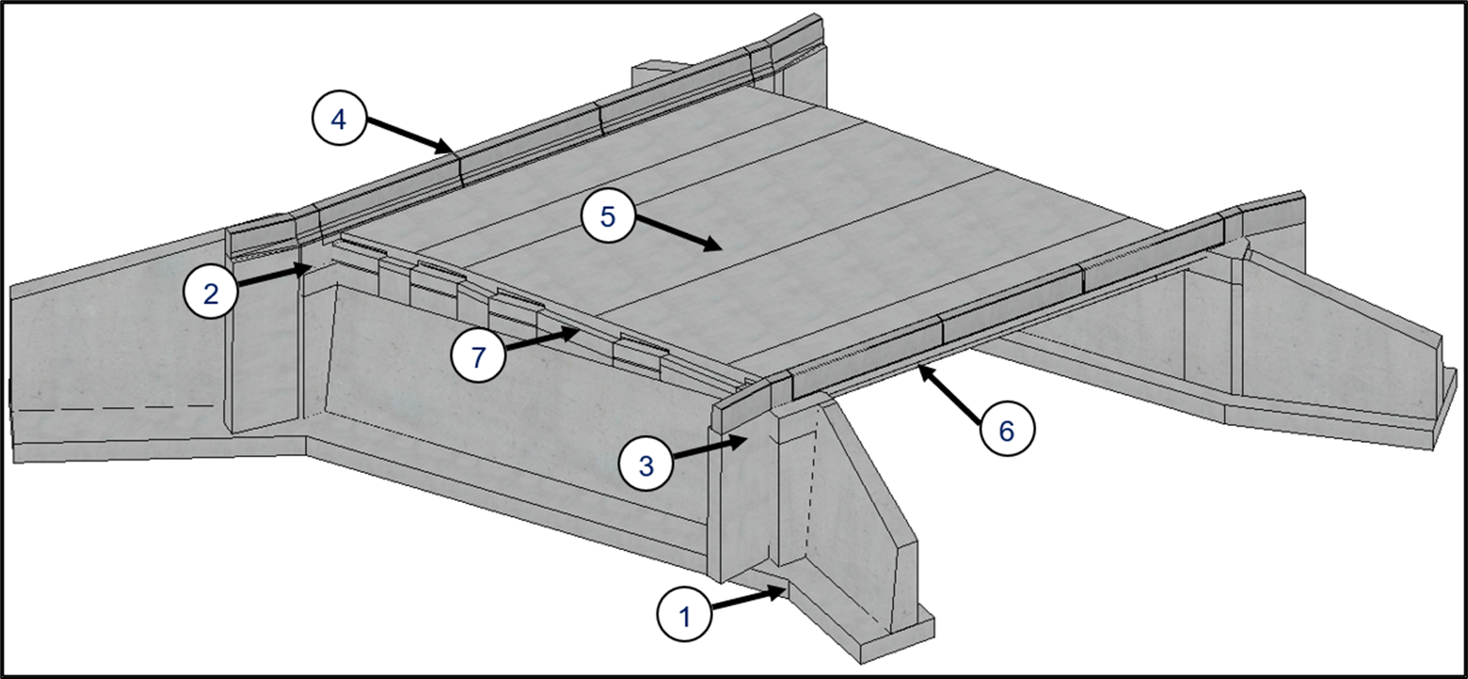
Refined Model
Notes:
Speaking Point
Refined Model
Can see deck ends skewed off
Monolithic substructure footing
Corner blocks
Safety wings with flare (older connection detail, but still can be modeled)
Diaphragms between beams, deck, and abutment top
Paving notch included
Barrier joints

Slide 37
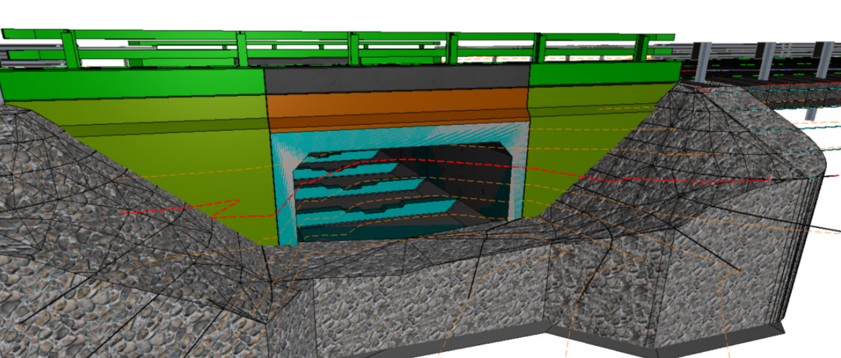
Culvert Modeling Workflow
There is no “culvert” button within OBD
Re-purposing and extending current tools and templates
Building on existing bridge modeling workflows
Notes:
Speaking Point

Slide 38
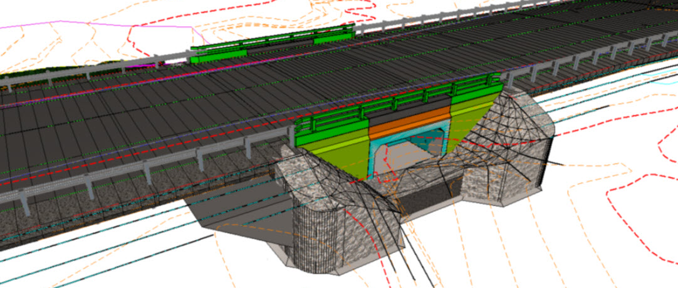
Culvert Modeling Workflow
Notes:
Speaking Point

Slide 39
Infrastructure Cloud

Slide 40
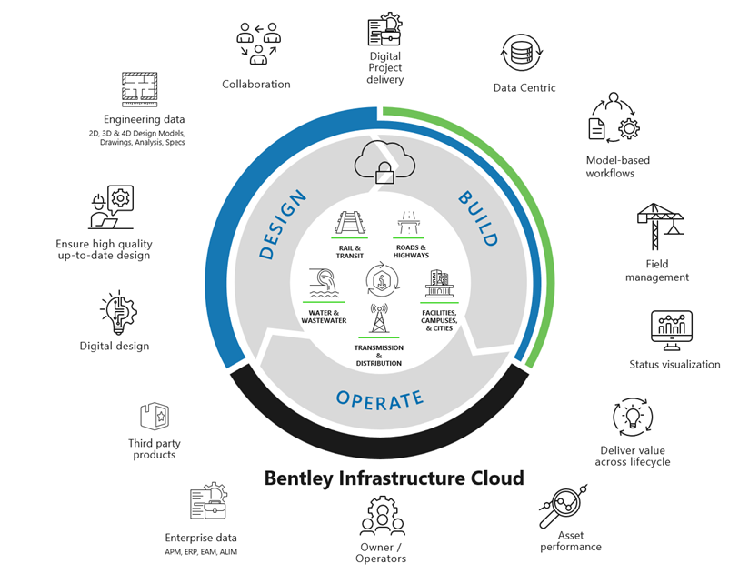
What is Infrastructure Cloud?
  Infrastructure Cloud is the latest version of Bentley’s cloud-based project portal that brings teams and projects together in a collaborative and managed environment.
Notes:
Speaking Point
Cloud-based model viewer and project portal
Has gone through multiple evolutions/renames:
ProjectWise 365
Synchro (Still the name used by the connected field app)
Infrastructure Cloud (current name)

Slide 41
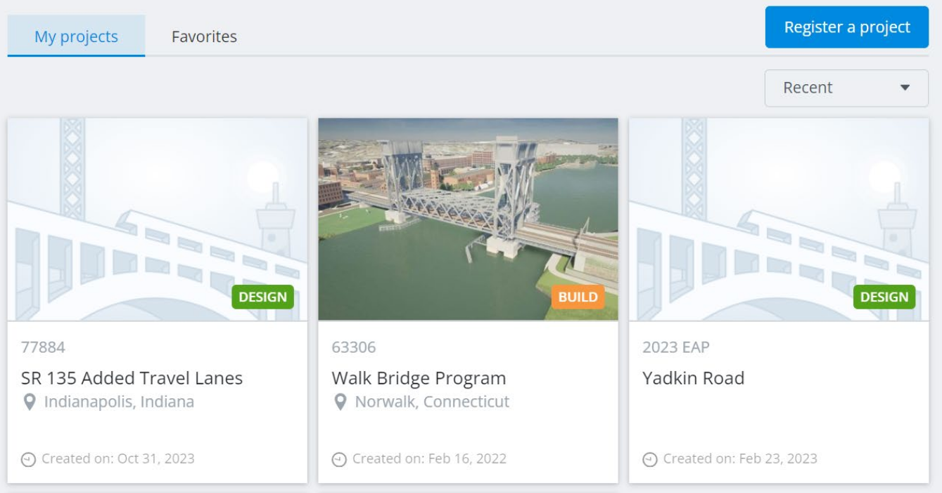
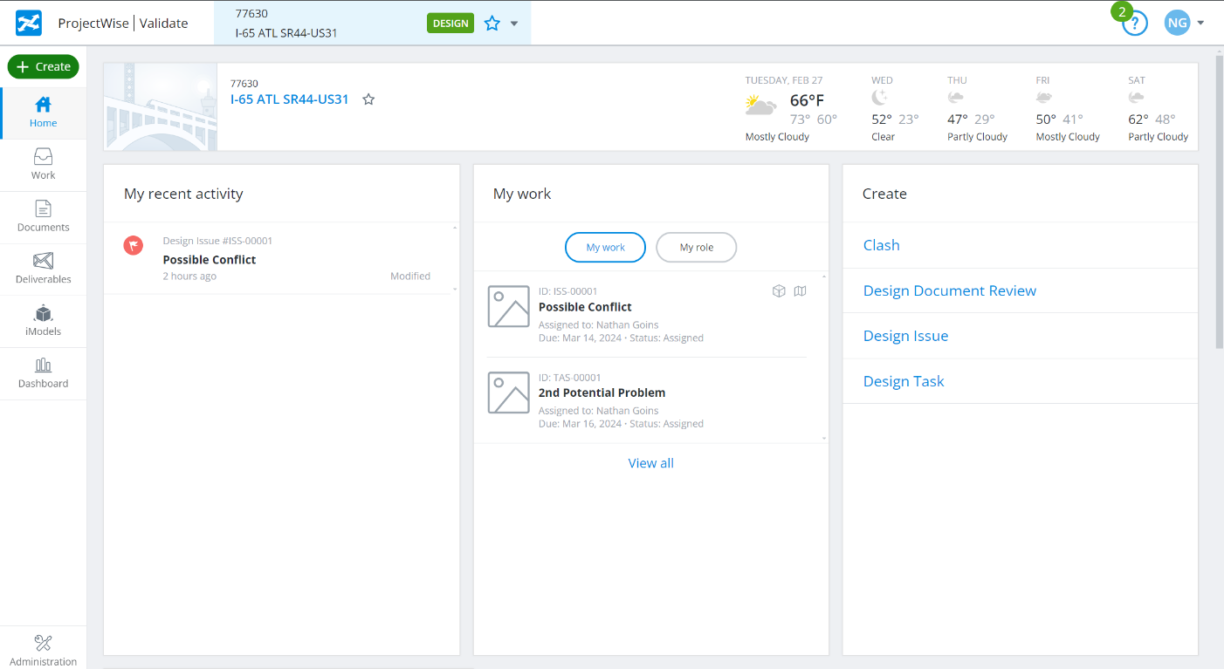
Landing Page / Project Page
Notes:
Speaking Point
My Project Page
Provides a tile-based layout of all the projects that the user has been granted access to.
Initial access typically provided by Systems Administrators who create/link the project from ProjectWise
Subsequent access can be provided by individuals granted Administrator status in each specific projects permissions portal.
Project Page
Each project has a similar dashboard that presents recent activity, assigned work or tasks, available iModels synced to the project, and an overall summary of the project status (clashes, design issues, submittals, RFI’s, etc.)
Menu bar to navigate between different pages of the project.
Work: Clashes, Issues, Design Tasks, etc.
Documents: Link to PW folders so data can be accessed directly in IC
Deliverables: Organizes and catalogs submissions
iModels: Create new iModels for project use. Can edit the iModels to setup such controls as what files are synced into the iModel and how frequently the iModel itself is updated.
Dashboard: Another way to track project status
Administration: For project admins.

Slide 42
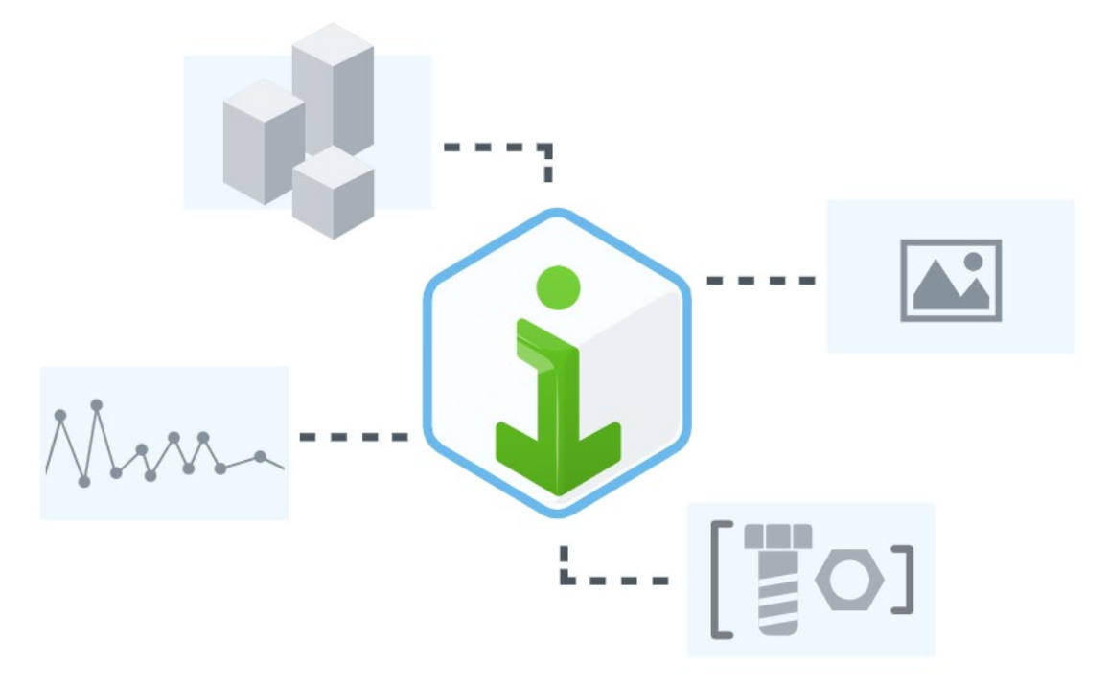
What is an iModel?
  A read-only container file used for sharing and managing project information
  - The equivalent of a PDF for 2D and 3D (BIM) content
Key features:
Visualization of complex 2D and 3D designs
Design snapshots at precise times
Can be published locally, or in the cloud
Collection from multiple sources
Share data between software platforms
Notes:
Speaking Point
iModels are the main model deliverable of Infrastructure Cloud
Rather than being created locally and uploaded, iModels in IC are created when designated files, hosted in PW, are synced together on the IC platform creating the model and making it shareable.
iModels can be assembled from data created on different platforms (such as Autodesk .dwg’s or .ifc files) and can access importable civil data from database sources like ESRI ArcGIS and mapping solutions (Bing, etc.)

Slide 43
iModel Example
Notes:
Speaking Point
SR 6 bridge example

Slide 44
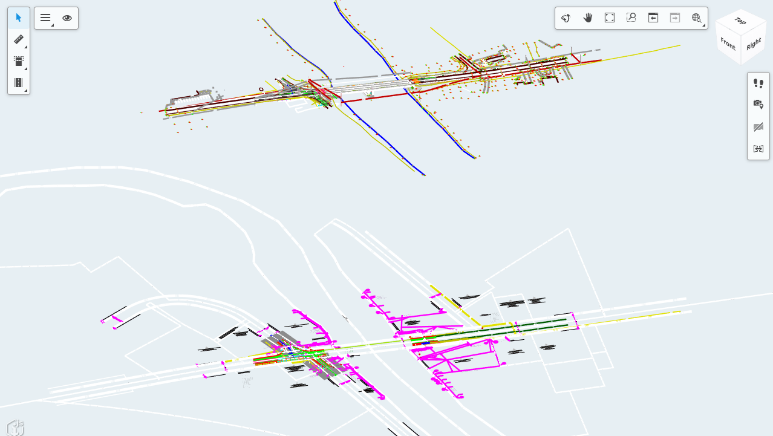
iModel Example
Notes:
Speaking Point
SR 6 bridge example
Show 2D information BELOW 3D bridge model

Slide 45
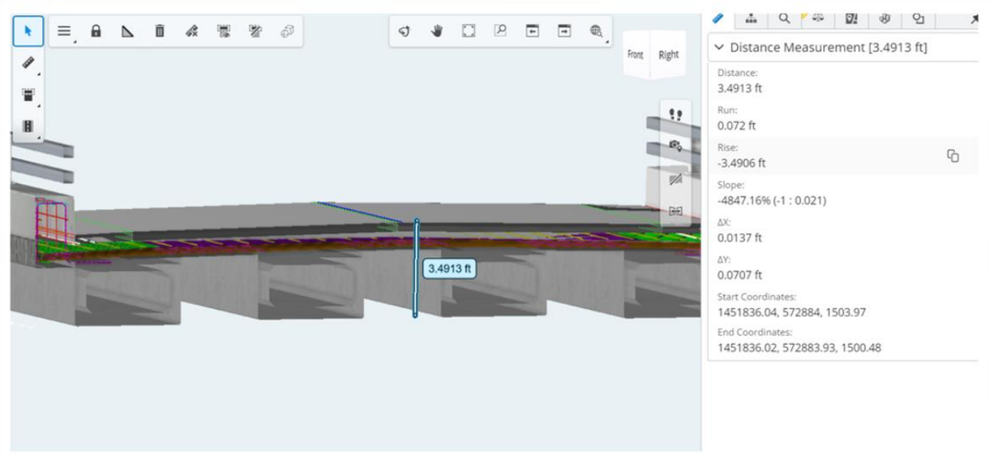
Review Tools
Notes:
Speaking Point
Measurement of 3D elements and components
Measurement/dimensions are persistent and can be selected to provide additional detail: slope, delta x/delta y, corodinates, etc.
Can be deleted individually or all measurements can be removed at once

Slide 46
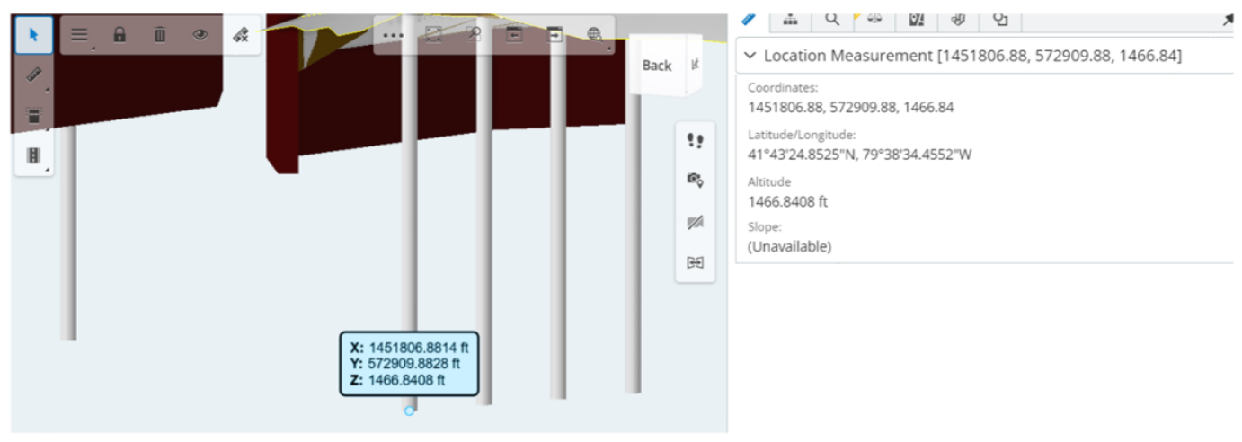
Review Tools
Notes:
Speaking Point
Measurement of 3D elements and components
Measurement/dimensions are persistent and can be selected to provide additional detail: slope, delta x/delta y, corodinates, etc.
Can be deleted individually or all measurements can be removed at once

Slide 47
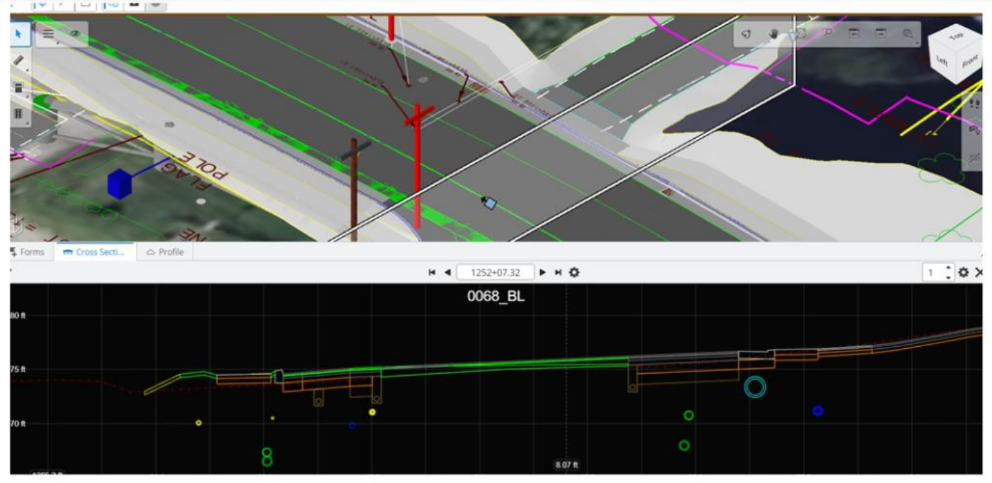
Review Tools
Notes:
Speaking Point
Cross-section generation
Can create 2D cross sections from a user defined plan within the model
Typically set perpendicular to an alignment (roadway, pipe, culvert, etc), but can be set anywhere need
Cross-sections can be annotated with dimensions, area measurements etc.
Annotations persist in the cross-section view as the cross-sections are advanced as long as the dimensions is attached to a fixed anchor point on an object (like the gutter line, or the area of a layer of pavement, as long as that layer is in the cross-section being viewed.

Slide 48
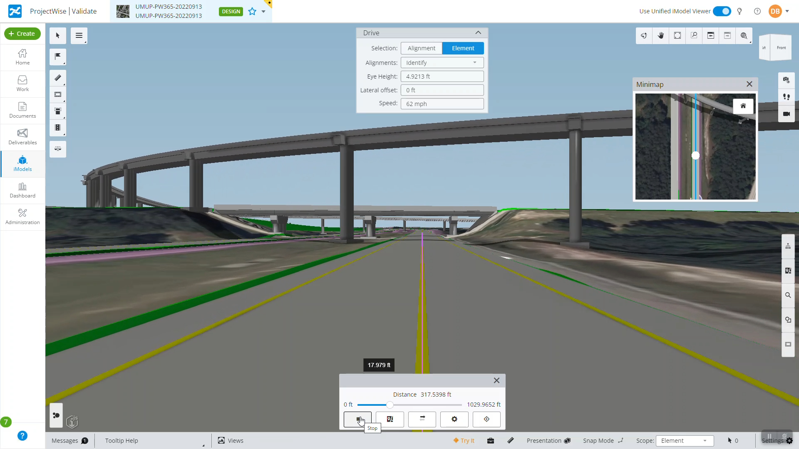
Review Tools
Notes:
Speaking Point
Drive Mode
Allows you to “drive” through the model by attaching the camera to an alignment and lets you advance or reverse along that alignment, rotating your view to see model elements and how they are being displayed/rendered.
Can set “eye height” to get an impression of what would be visible from vehicles of differing heights.
Minimap shows you the camera position within the model in a plan view
Can create Saved Views while in Drive Mode

Slide 49
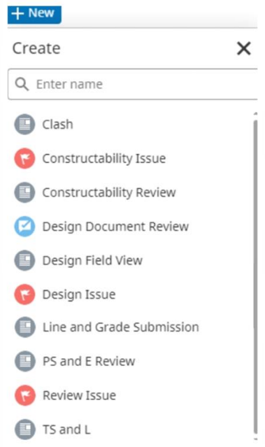
Forms
Key features:
Flags design issues or adds comments in models/PDFs
Can be marked up and commented on by reviewers
Assigned to individuals or roles
Includes status, due date, comments, and markups
Notes:
Speaking Point
Forms can be used in a variety of ways.
Can be customized by project administrators as required
Used to identify and track issues with the model
Flags can be attached to model elements
Forms/Issues can be assigned to roles and individuals as needed

Slide 50
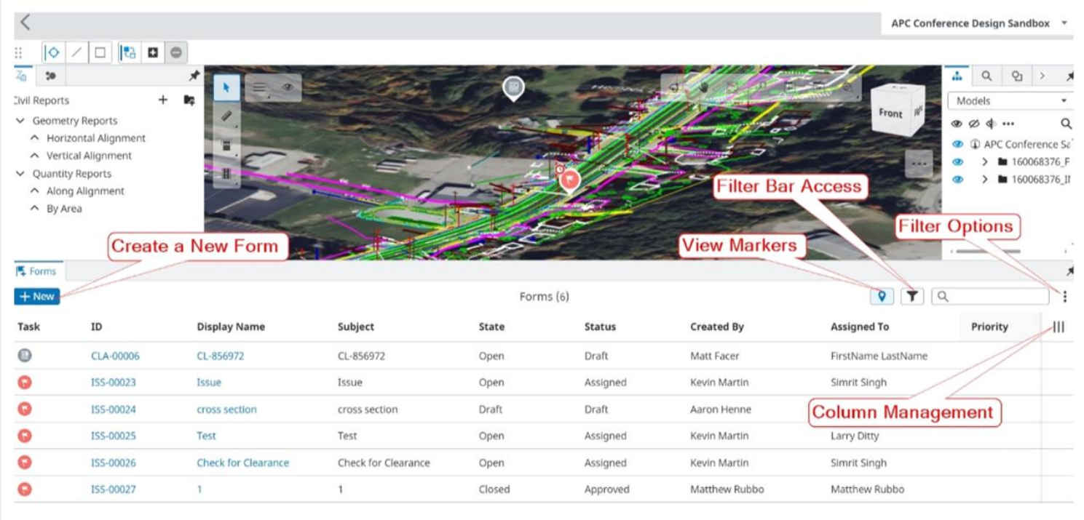
Forms
Notes:
Speaking Point
Example Forms management page

Slide 51
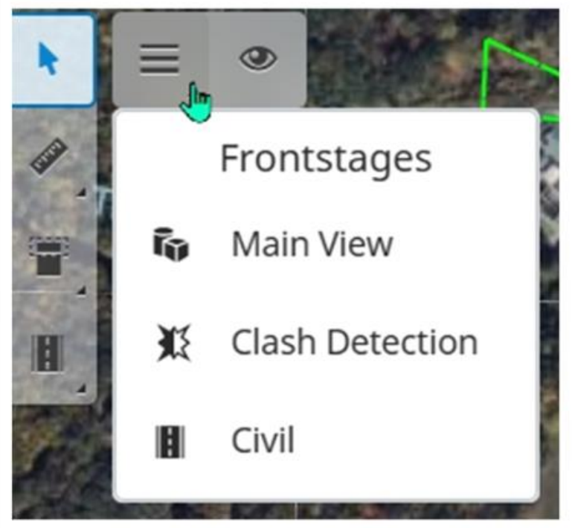
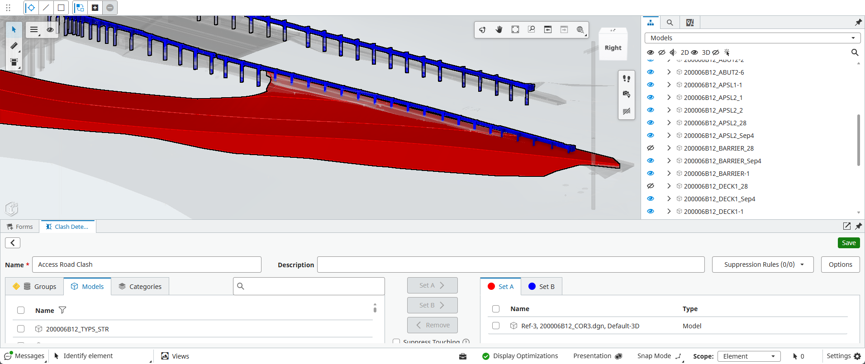
Clash Detection
Notes:
Speaking Point
Clash Detection Frontstage
Used to identify intersections/conflicts (“clashes”) between different model elements
Set element groups/layers and then run analysis to determine any conflicts present
IC creates a list of conflicts and summarizes them

Slide 52
QUESTIONS?

Slide 53
Keith Gayman, PE
Michael Baker International – Harrisburg, PA
Keith.gayman@mbakerintl.com
O: 717-221-2023
Michael Kuhns, PE
Michael Baker International – Harrisburg, PA
Michael.kuhns@mbakerintl.com
O: 717-213-6221

