Slide 1



ASHE Back-to-Basics | Drainage
Speaker: Matt burlew, pe
Wilson Consulting Group, PC
MattB@WilsonEP.com
717-553-0976

Slide 2
INTRODUCTION
2 of 25
Wilson Consulting Group
Active Transportation
Messiah University

Slide 3



PRINCIPLES OF DRAINAGE
3 of 25
Conveyance
Inlet | Pipe | Swale | Trench Drain | Berm
Treatment
Basin | Raingarden | Permeable Pavement | Infiltration Trench | Vegetative Filter Strip
Discharge Point
Inlet
Storage/ Treatment Facility
Pipe
Swale
Receiving
Watercourse
Notes:
Drainage can essentially be separated into two categories; conveyance and treatment. Conveyance structures generally consist of inlets, pipes, swales, trench drains, and berms. Some of the treatment facilities that you may encounter are basins, raingardens, permeable pavement, infiltration trenches, and vegetated filter strips. Drainage design also goes hand-in-hand with Erosion Control design and permitting. I will touch on those a little bit throughout but there will be other webinars dedicated to discussing those more in depth.

Slide 4
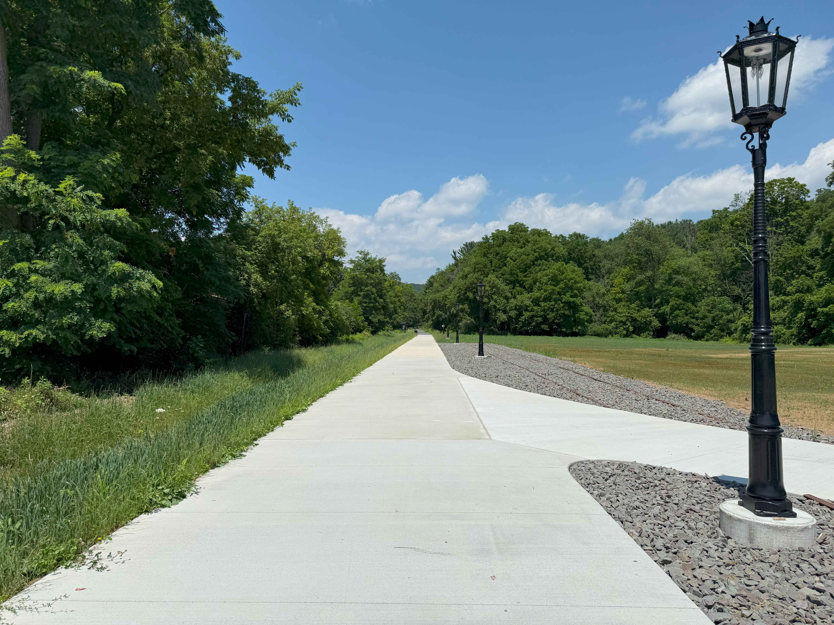
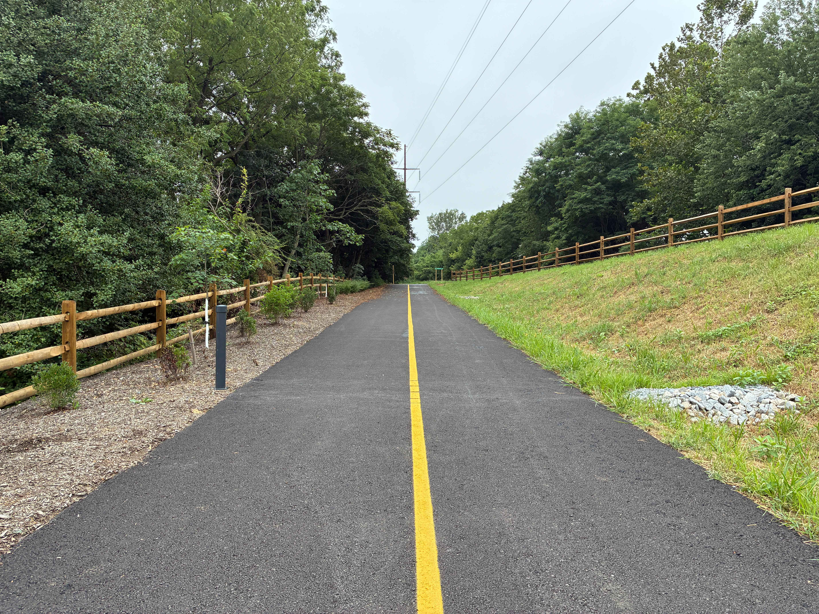
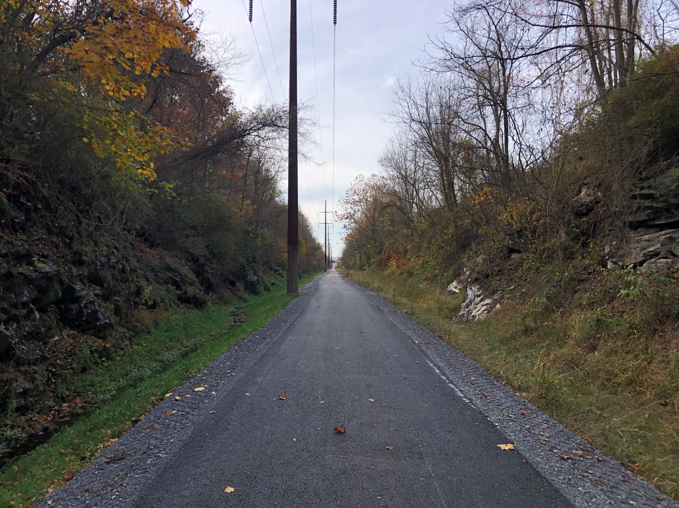
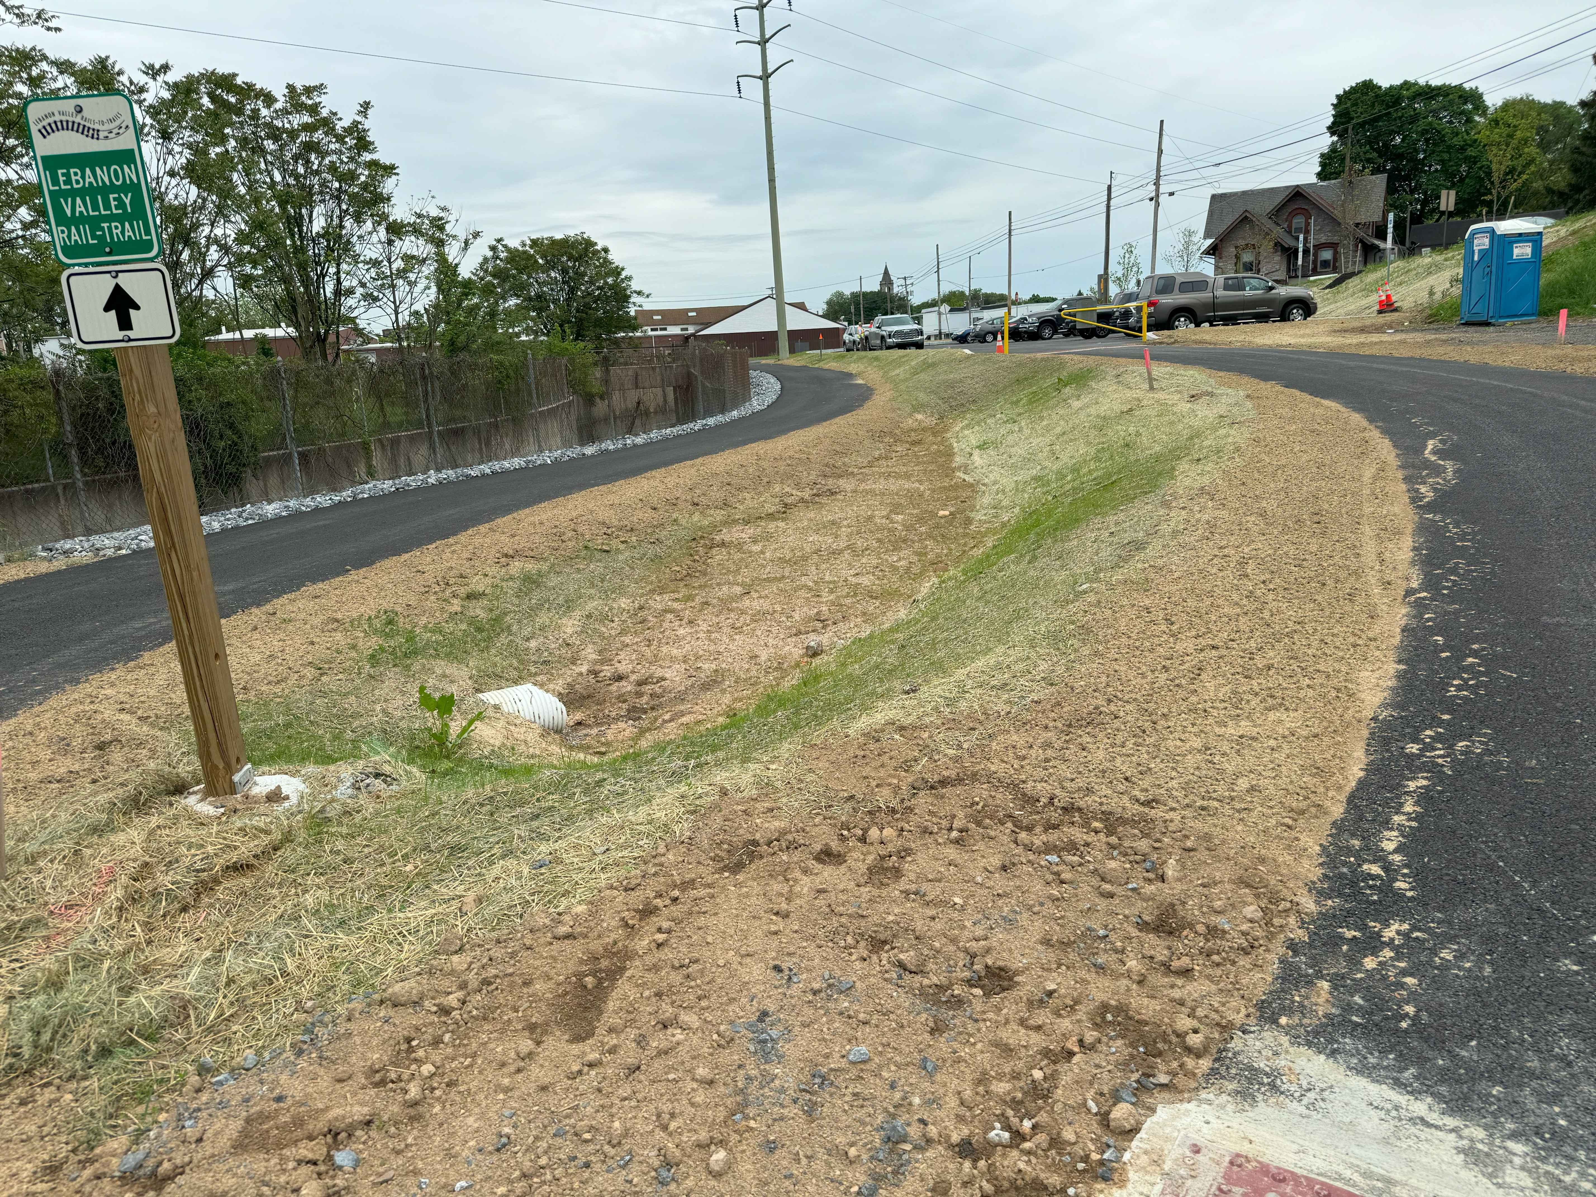
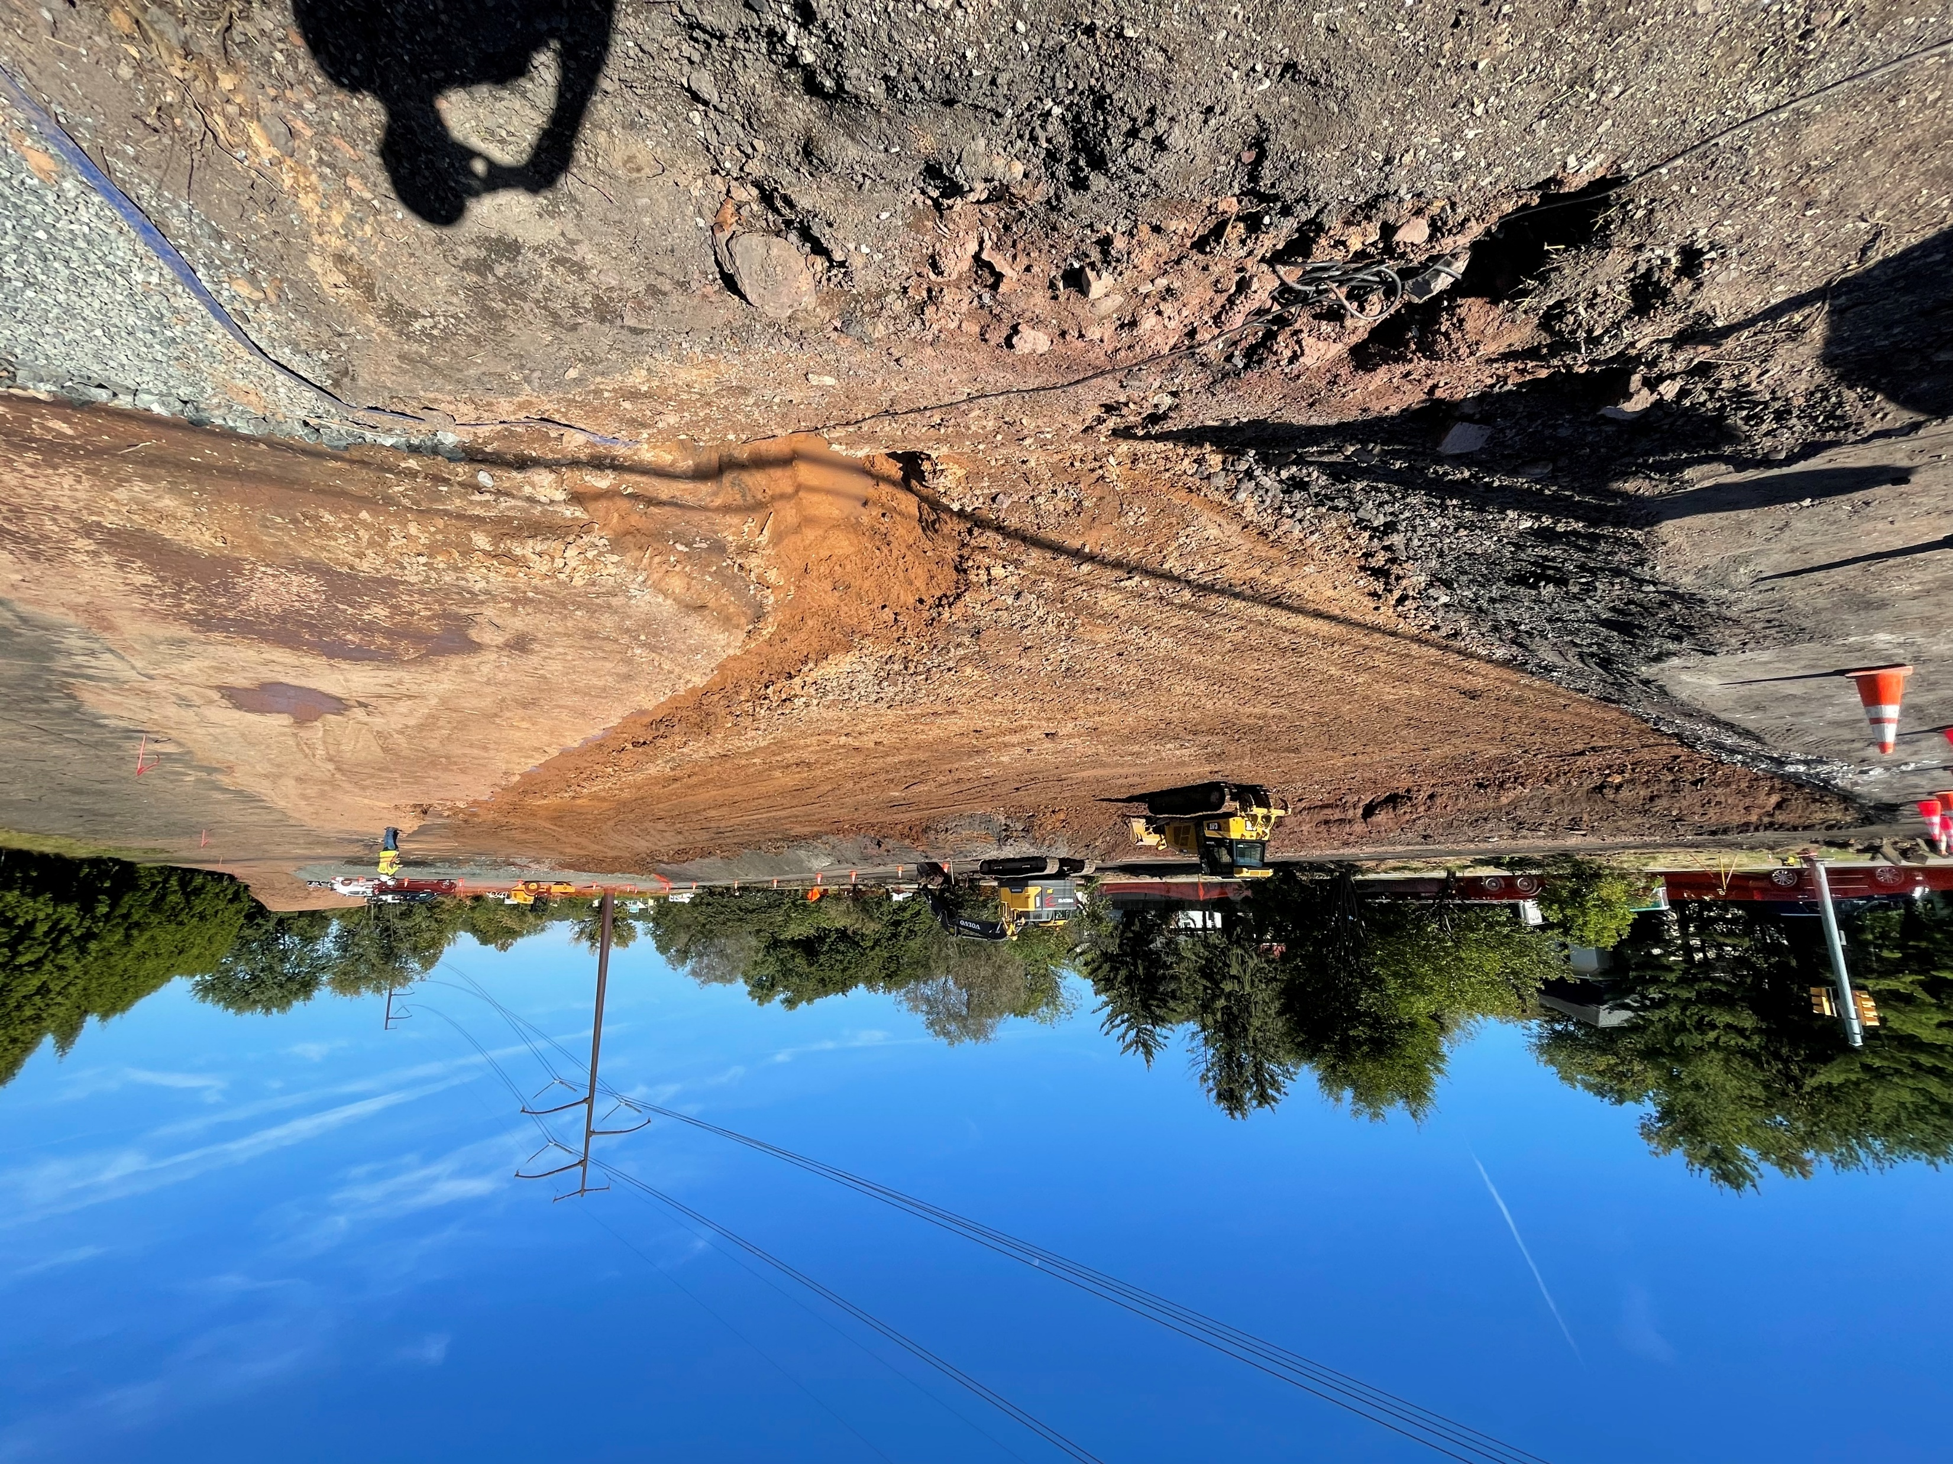
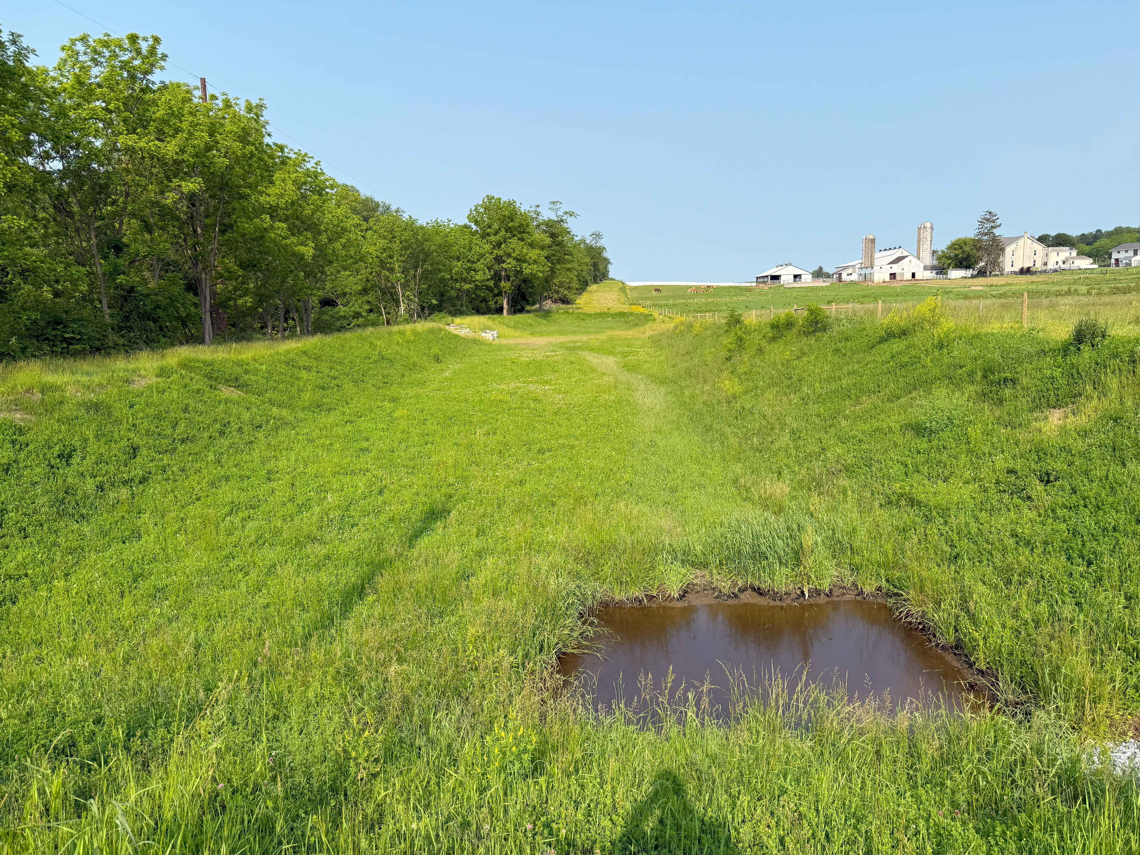
PROJECT SPECIFIC EXAMPLES
4 of 25

Slide 5

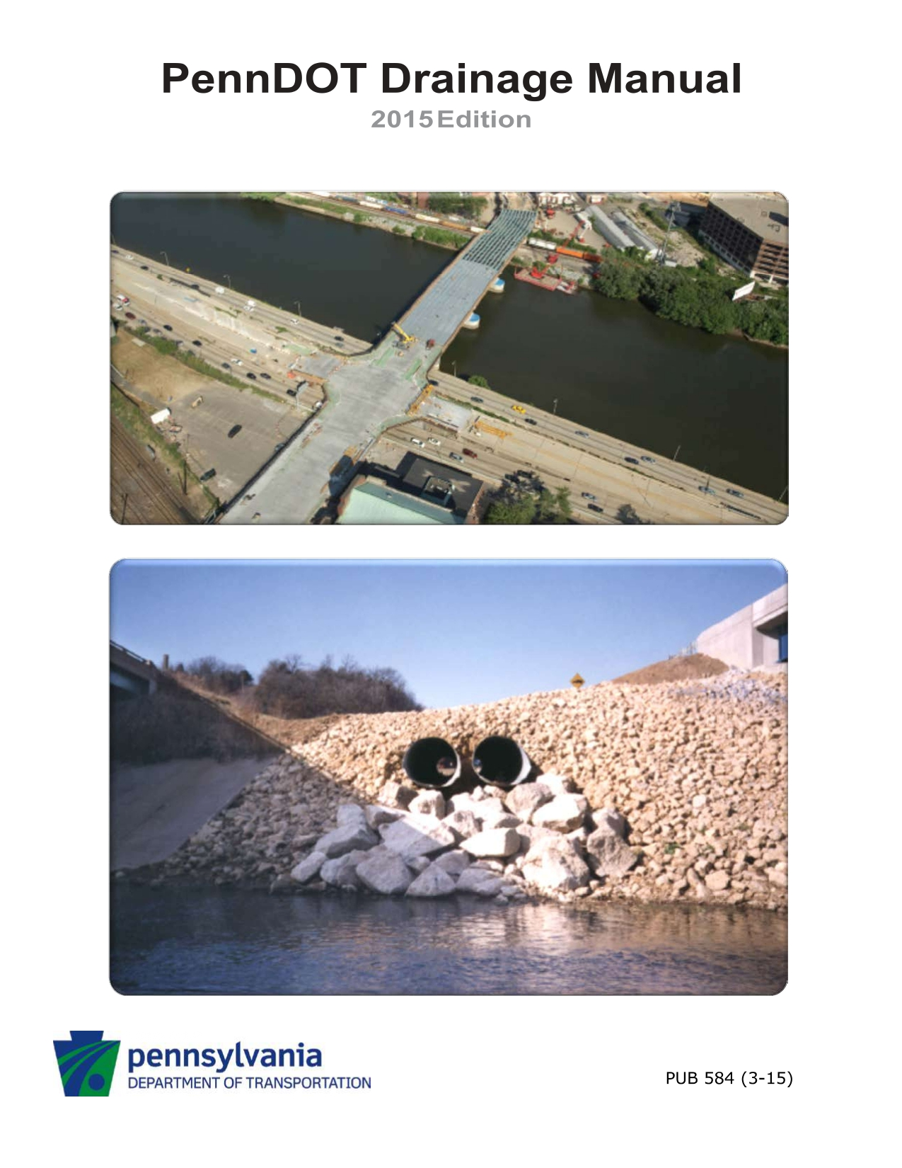

DRAINAGE STANDARDS & GUIDES
5 of 25
Notes:
On screen are some of the more dedicated and relevant manuals for drainage design. The first is PennDOT’s Publication 584 which covers all things drainage. The second is DEP’s manual on stormwater management. I should note that this is currently a draft document but is a step up from their one from 2006. We are hoping to get the final release here shortly. The third and last manual is DEP’s E&S manual. This supports their PCSM manual but mainly focuses on erosion control as the name suggests.

Slide 6
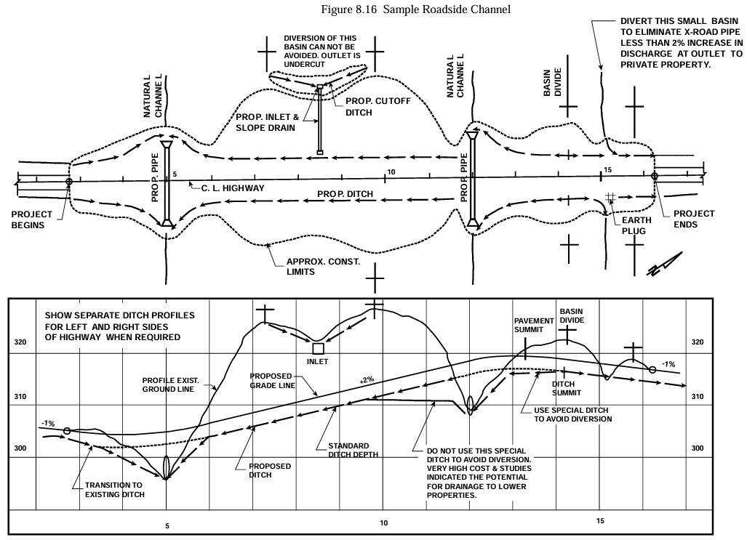



FUNDAMENTALS FOR DESIGN
6 of 25
Setting
Design Storm
Flow Rate (Q)
Notes:
There are a few fundamental aspects to every design. Setting is by far the most general, but it provides a crucial starting point. Where is water coming from? Where does it need to go? How much height or width do we have access to? The design storm is the next piece of information that drives the design. Are we designing for a 10-year storm, 25-year storm, or even a 100-year storm? This helps us determine the flow rate that will need to be managed by the facility. From there it is an iterative process to refine the design as needed. The two diagrams on screen show a sample of roadside stormwater facilities and how they interact as part of a full project. There are some pipes that simply connect channel while another directs water to a basin. Parallel swales are very common features along roadways, both to capture runoff and to prevent water from flowing onto the roadway from off-site.

Slide 7
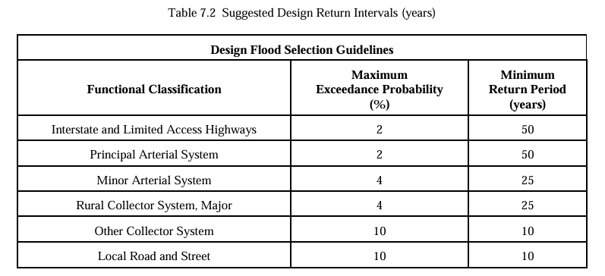
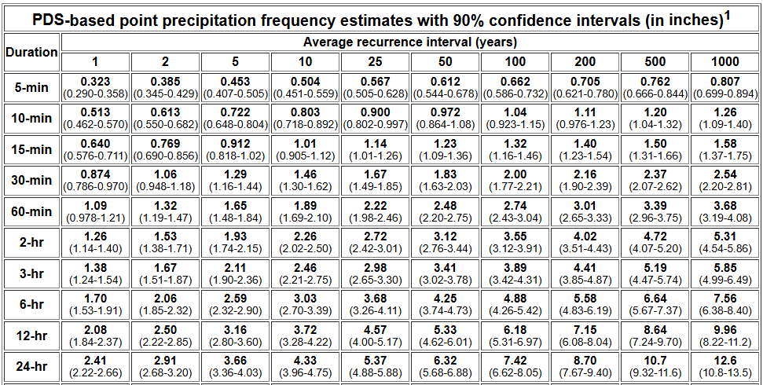
DESIGN STORM
7 of 25
PennDOT Pub 584
NOAA Atlas 14
Notes:
PennDOT’s Pub 584, specifically Table 7.2, provides the design storm for your inlets and pipes. For example, if you are designing an interstate you will need to account for the 50-year storm. A Local Road, on the other hand, would only need to manage the 10-year storm. NOAA Atlas 14 is a great resource for determining the precipitation depth for the various storm durations and frequencies at your specific site location. If we are designing for a 10-year 24-hour storm, for example, we could find that the precipitation depth for this location is 4.33 inches.

Slide 8
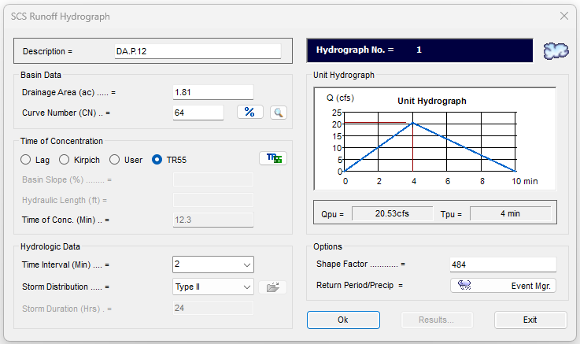
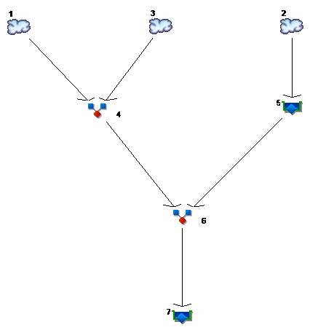
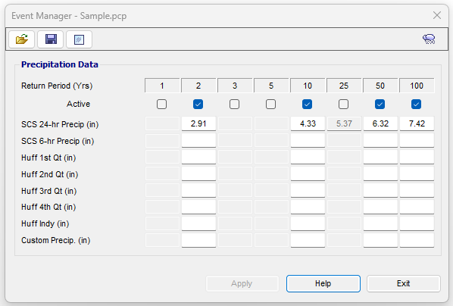
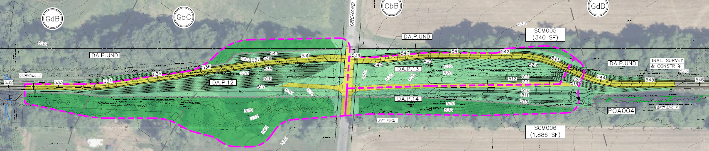
FLOW RATE (Q)
Hydraflow Hydrograph
8 of 25
DA.P.12
DA.P.14
DA.P.13
SCM005
SCM006
Notes:
There are a multitude of programs that help you determine flow rates for your site. I utilize Hydraflow Hydrographs which is an extension to Autodesk’s Civil3D program. HydroCAD is also another one that could be helpful. You first input the precipitation rates for the various storm durations that were determined with NOAA Atlas 14. You can then create a watershed system that combines and separates drainage areas as well as model your stormwater treatment facility, shown in the top middle picture. The top right picture shows you the input fields for a Hydrograph. Here you input things like cover types, areas, and time of concentration to generate a flow rate. In the example we have on screen, there are two infiltration basins, designated as SCM005 and SCM006. It may be hard to see but the site can be separated into three drainage areas, 12, 13, and 14. Runoff in Drainage Area 12 will pass through a pipe into Drainage Area 14 before entering SCM006. Runoff from Drainage Area 13 will go directly into SCM005. The overflow of SCM005 is connected to SCM006. The graphic in the top middle shows how the Hydrograph can be set up to mimic these flow patterns.

Slide 9
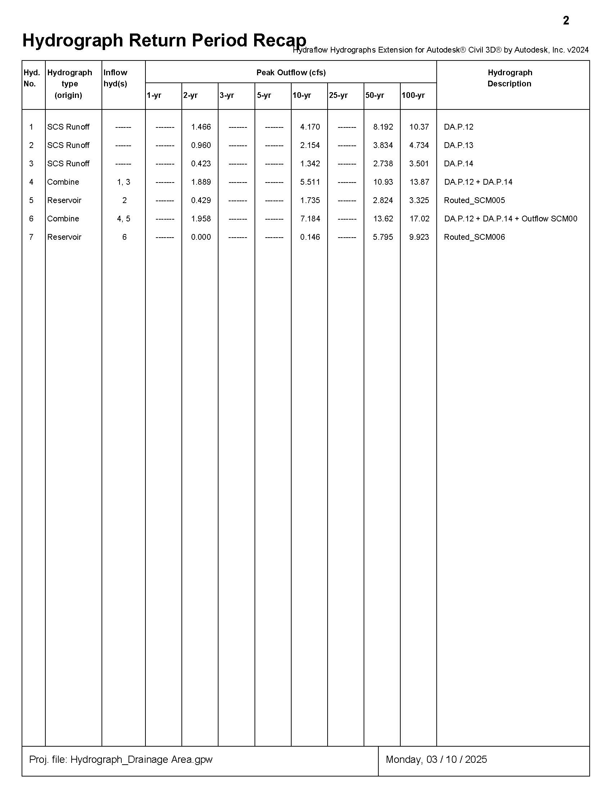
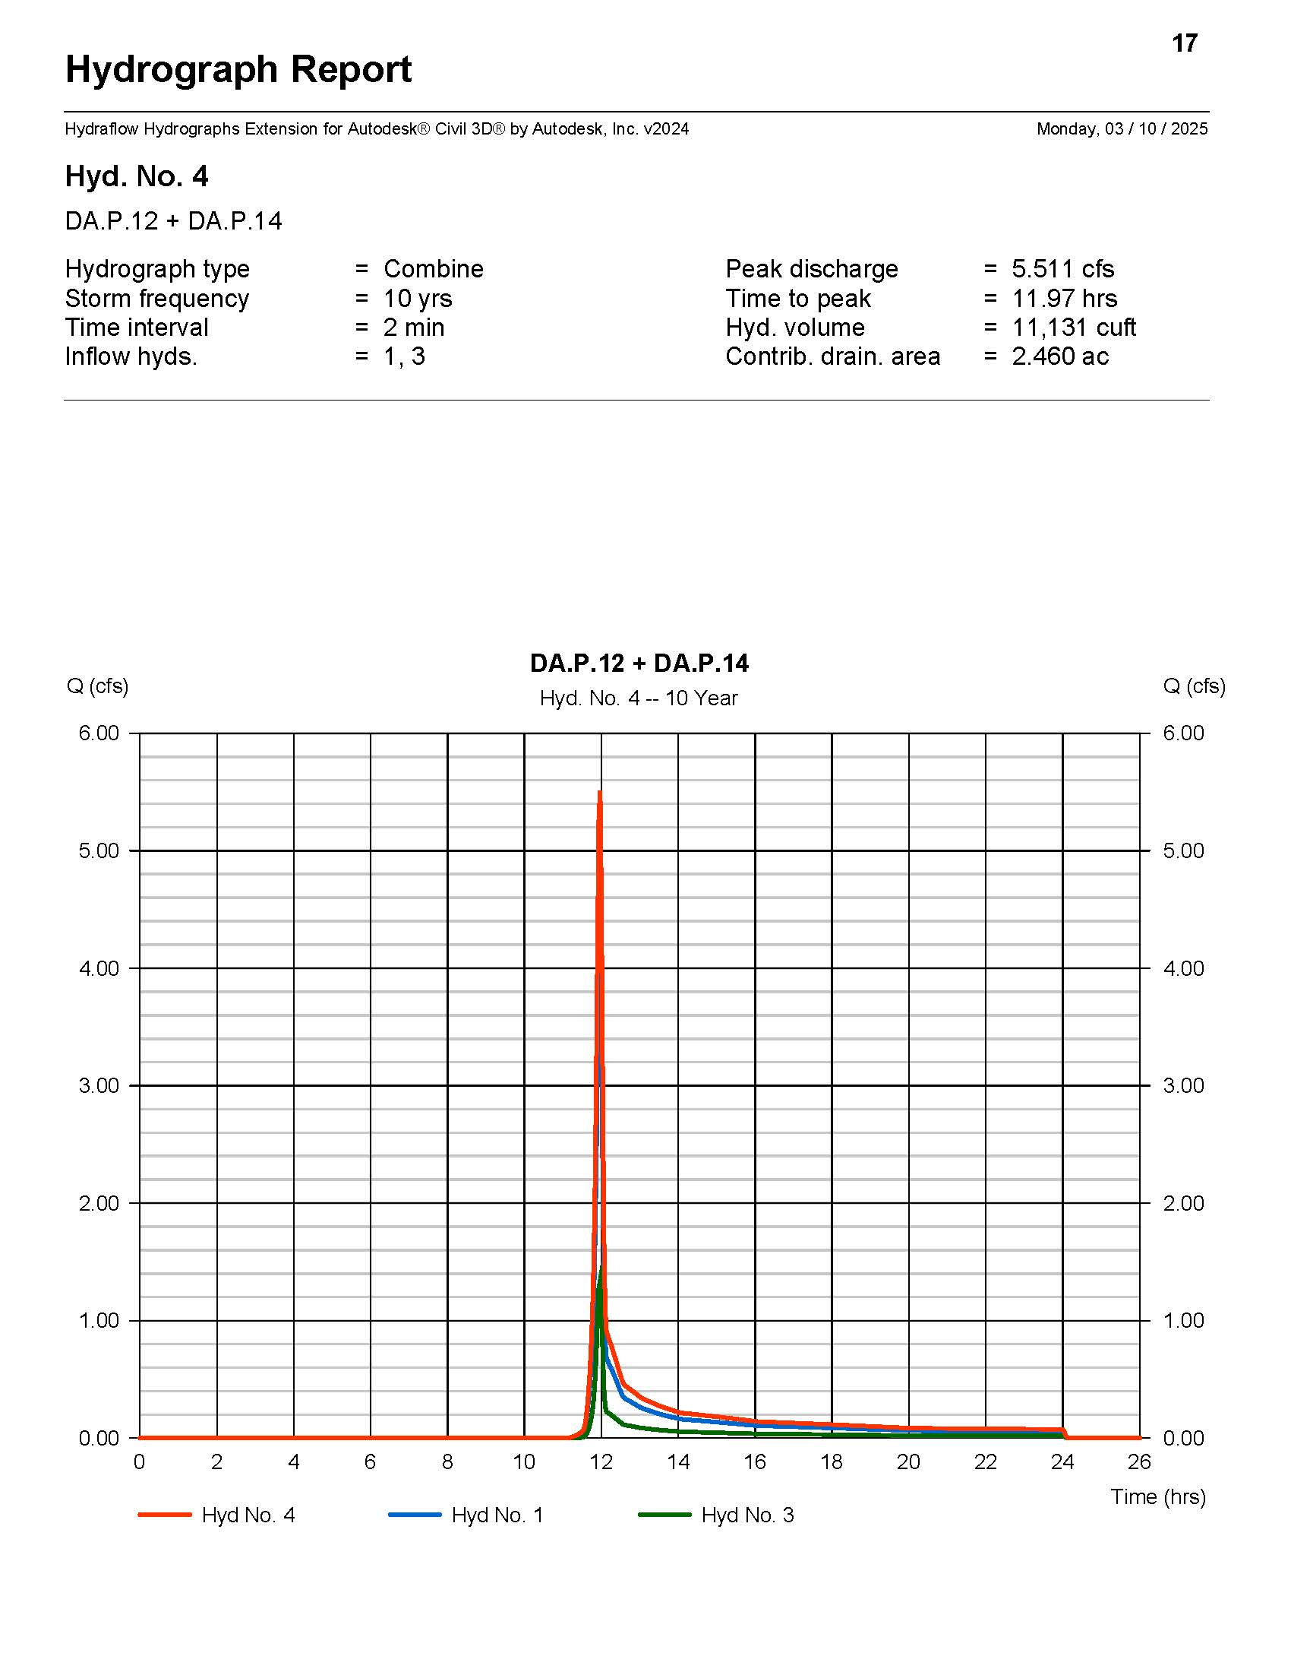
FLOW RATE (Q)
9 of 25
Hydraflow Hydrograph
Notes:
From the information that we have inputted into the Hydrograph model, a report can be generated to find the peak flow rates at each stage and design storm. The left image is a summary of all of the storm events, while the right image contains a little more information on a specific storm. For the project on the screen, the amount of water entering SCM006 is 7.184 cubic feet per second during the 10-year storm, while the amount of water leaving SCM006 is 0.146 cfs.

Slide 10
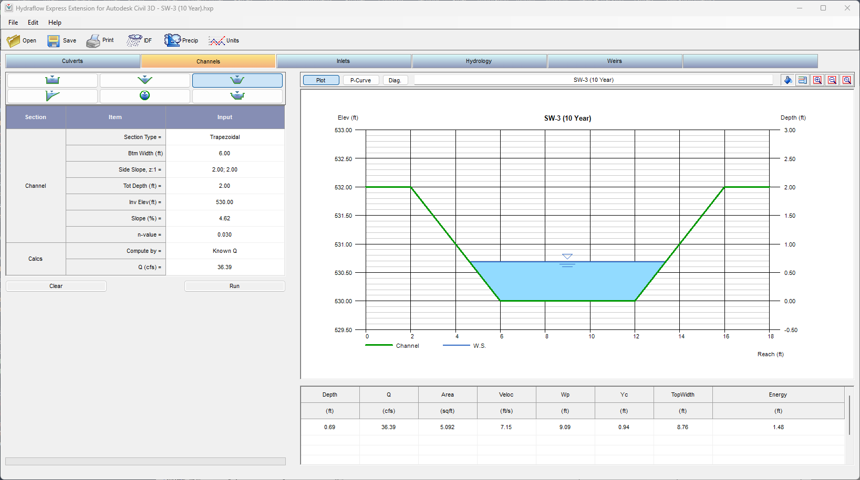
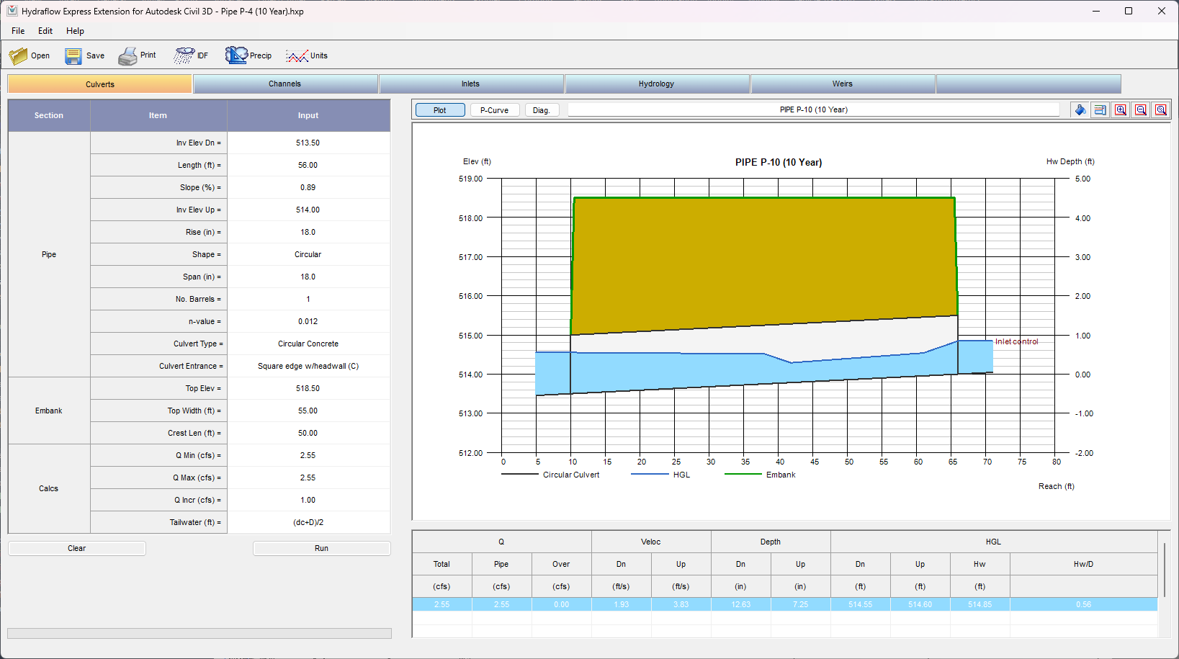
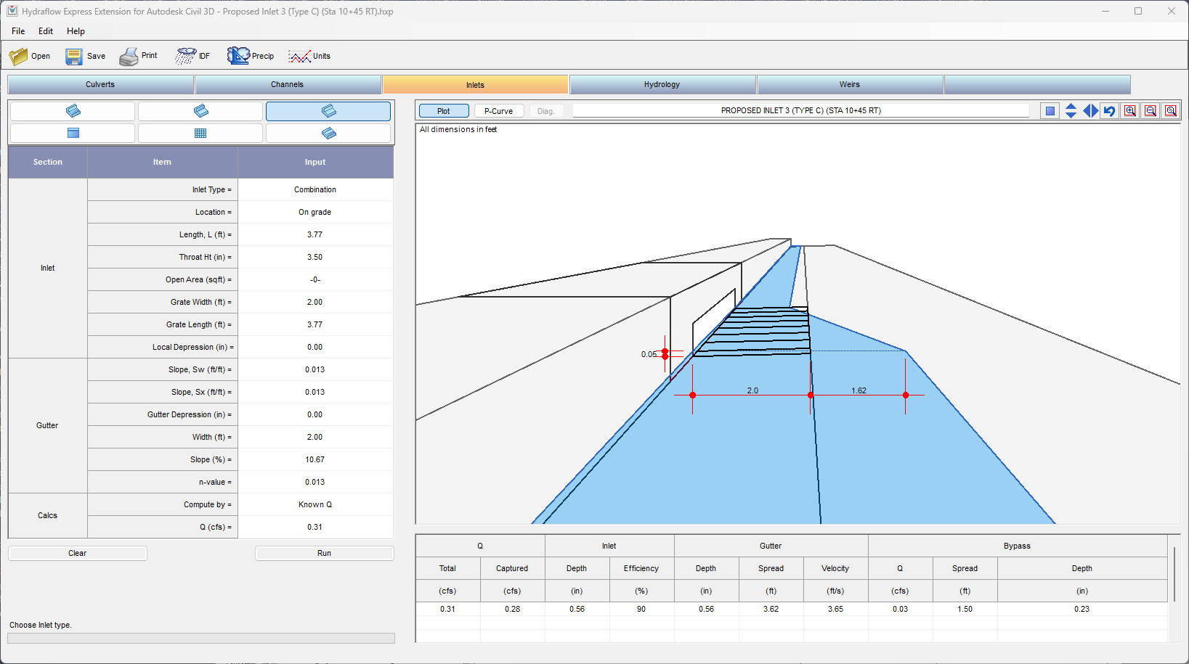
10 of 25
STORMWATER CONVEYANCE
Hydraflow Express
Notes:
Utilizing the flow rate determined in the last slide we can input that data into Hydraflow Express, another Autodesk Civil3D extension, along with the various characteristics of our swale, pipe, or inlet to determine whether or not they have been sized properly. Again, stormwater design is an iterative process so you may need to adjust your parameters, as necessary, to withstand the peak flow.

Slide 11
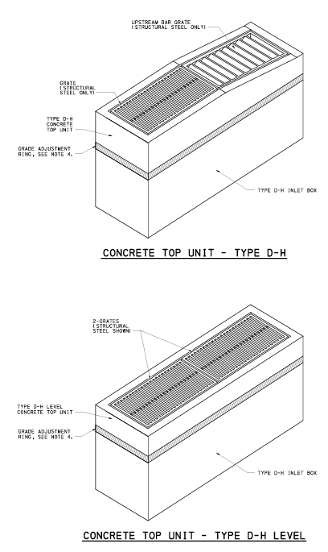
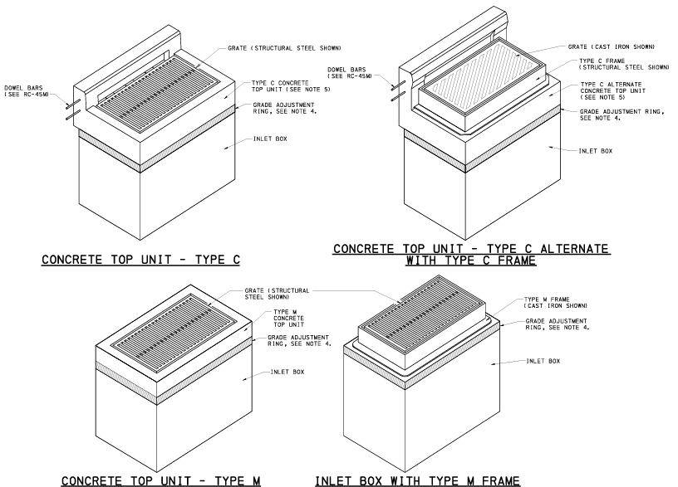
STORMWATER CONVEYANCE (INLET)
11 of 25
PennDOT Pub 72M
Notes:
Moving to more PennDOT specific items, Pub 72M contains information on standard inlets and pipes. Here you can see the different types of inlet tops (Type C, M, and D-H); all very common for roadways.

Slide 12
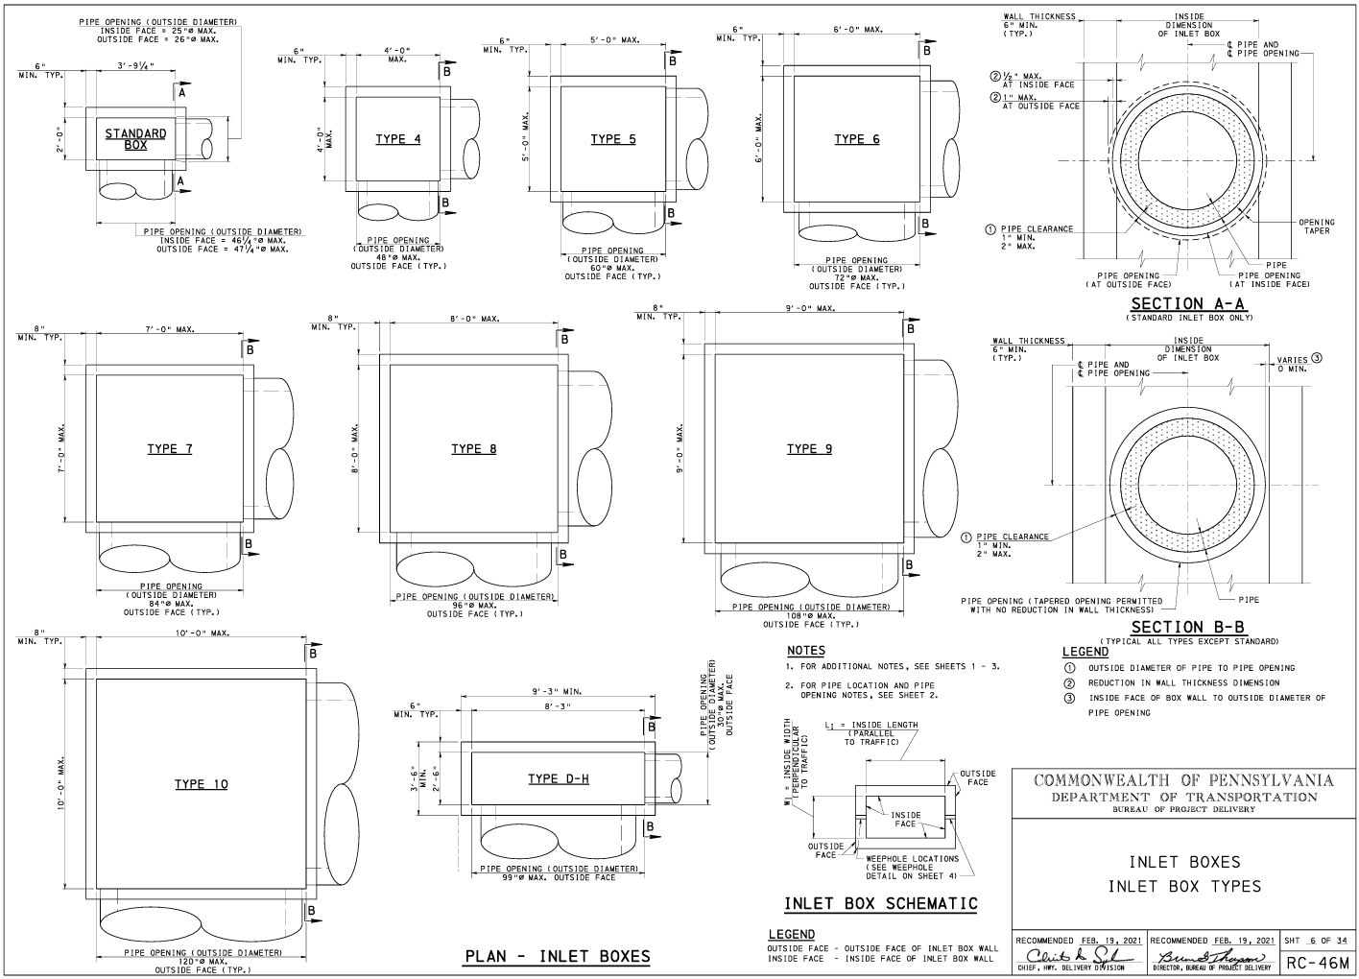
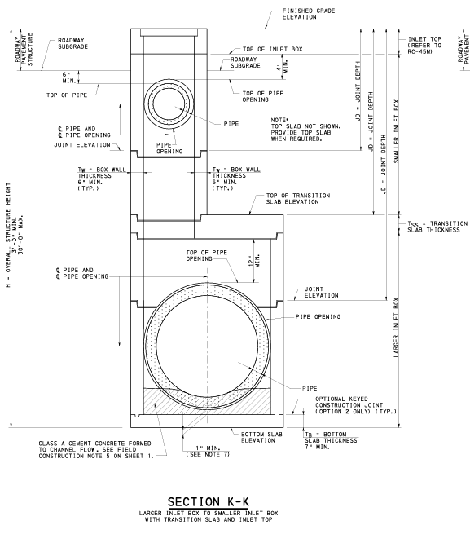
STORMWATER CONVEYANCE (INLET)
12 of 25
PennDOT Pub 72M
Notes:
These graphics show the various inlet box sizes. Bigger boxes may be required for larger or a greater number of pipes. The picture on the right shows the whole inlet and pipe setup with some of the requirements like cover and clearance that you will need to account for. Usually, the standard box will be appropriate for most sites.

Slide 13
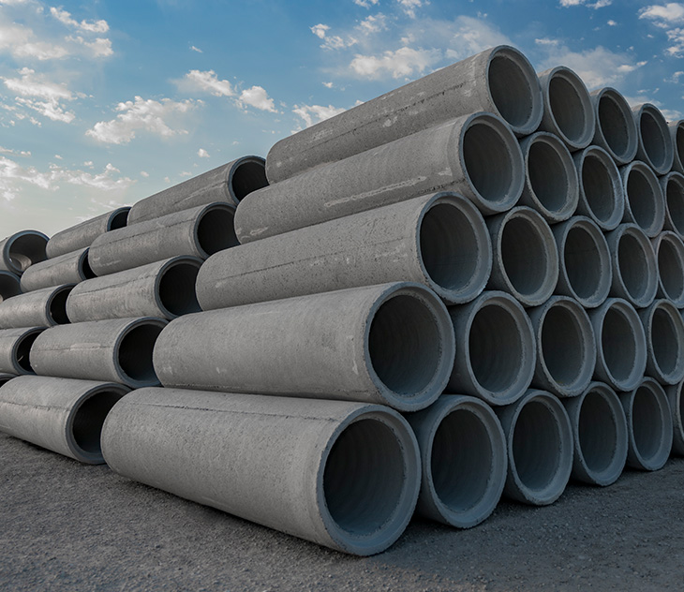
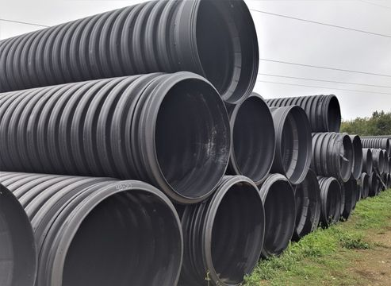
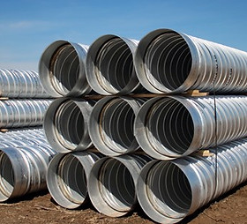
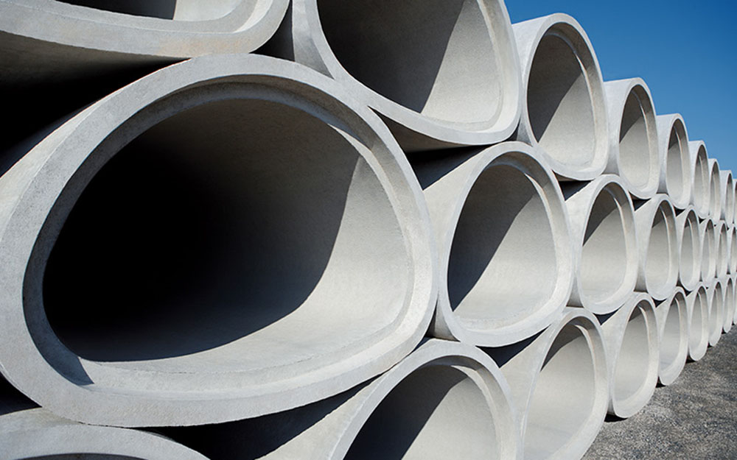
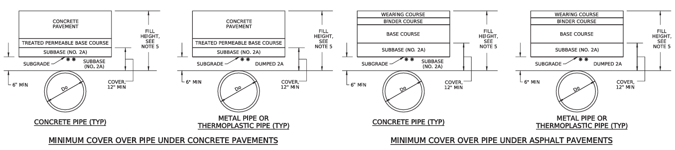
STORMWATER CONVEYANCE (PIPE)
13 of 25
Notes:
There are essentially three different materials classifications in the PennDOT world for pipes; concrete, thermoplastic, and metal (which can include aluminum, steel, or cast iron). Concrete pipes can also be elliptical in shape. The bottom image is another excerpt from Pub 72M that shows the required cover over a pipe when under a roadway. Each pipe material has its advantages and disadvantages which could range from price, durability, availability, and if connecting to an existing pipe, it would need to match material, type, and size.

Slide 14
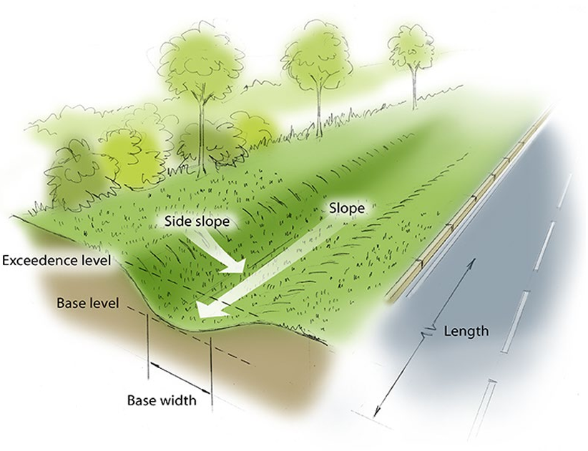
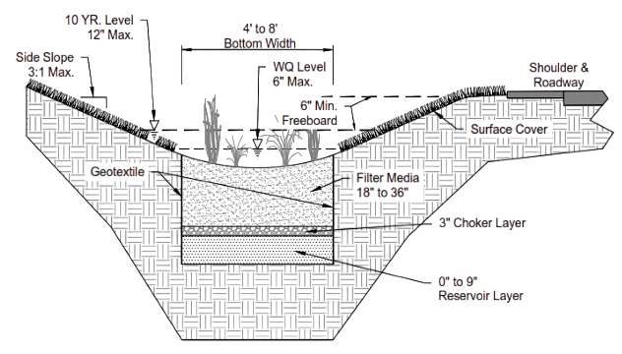
STORMWATER CONVEYANCE (SWALE)
14 of 25
Swale Lining
Swale Freeboard
Notes:
When it comes to swales shear, velocity, and freeboard generally dictate design. The swale will need to be constructed correctly to withstand the shear force and velocity of the water. We use temporary and permanent liners, such as control products and rock lining, to keep the swale from eroding. DEP’s E&S Manual contains information and requirements related to these. Freeboard refers to the difference in height between the flow line and the overtopping point. This will generally need to be a minimum of 6 inches, but it may be more depending on other standards and ordinances.

Slide 15
PRINCIPLES OF DRAINAGE
15 of 25
Conveyance
Inlet | Pipe | Swale | Trench Drain | Berm
Treatment
Basin | Raingarden | Permeable Pavement | Infiltration Trench | Vegetative Filter Strip
Discharge Point
Inlet
Storage/ Treatment Facility
Pipe
Swale
Receiving
Watercourse
Notes:
So that wraps up the discussion on stormwater conveyance. Are there any questions up to this point before I transition to discussing treatment facilities? … Some of the more common treatment facilities include basins, vegetated filter strips, and infiltration trenches. It's good to know that DEP uses the term Stormwater Control Measure, or SCM, when referring to a treatment facility. I will be using this term periodically.

Slide 16
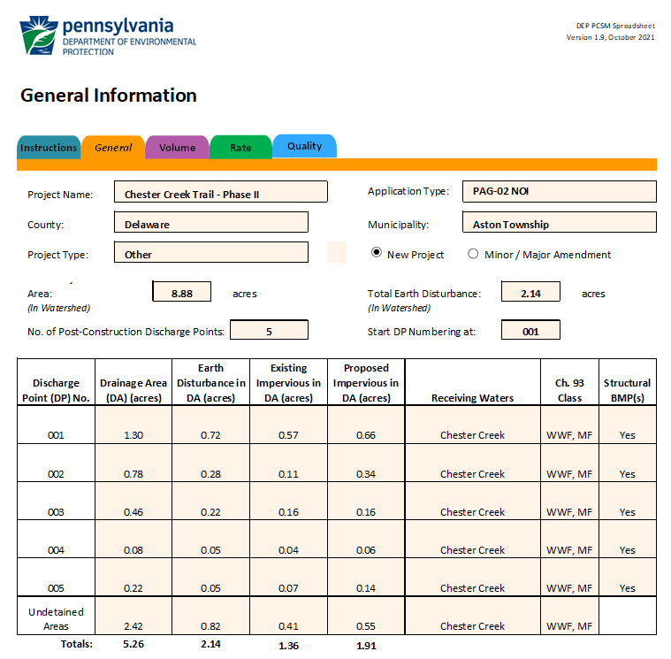



STORMWATER TREATMENT
16 of 25
Volume (CF)
Rate (CFS)
Quality (LBS)
Notes:
In terms of stormwater treatment, it really boils down to managing three separate areas (Volume, Rate, and Quality). DEP developed a very useful spreadsheet that breaks down each area very simply and helps you, as the engineer, design your stormwater facility more efficiently. They also have an instruction manual that details all of the inputs individually. I highly recommend having this open as you work through the spreadsheet. The graphic on screen shows just the General Tab of the spreadsheet where you detail some of the basics of your site.

Slide 17
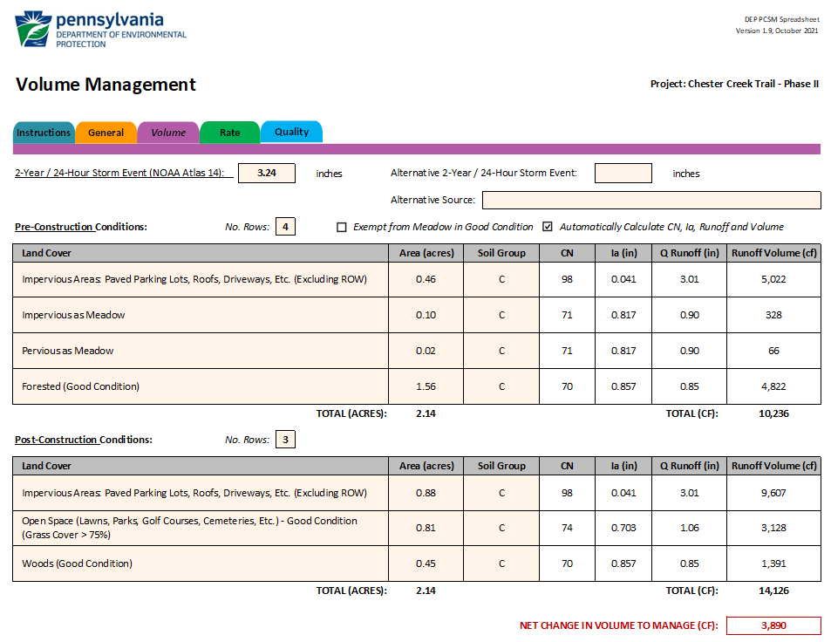
STORMWATER TREATMENT (VOLUME)
17 of 25
Notes:
Let’s take a look at the first category, Volume. To meet the PA Code, the total amount of Post-Construction runoff will need to be less than that in the Pre-Construction condition. To figure this number out, you start by filling out the first section of the Volume Tab. For the example on the screen, the existing site has 0.46 acres of impervious, 0.10 acres of impervious as meadow, 0.02 acres of meadow, and 1.56 acres of forested surfaces. This results in 10,236 cubic feet of runoff Pre-Construction. Post-Construction, there will be 0.88 acres of impervious, 0.81 acres of Open Space, and 0.45 acres of woods. This results in 14,126 cubic feet of runoff in Post-Construction. The total volume difference that will need to be managed by the stormwater facilities is 3,890 cubic feet. I should explain Impervious as Meadow for a second before I discuss the rest of the Volume Tab. This cover type is only for the Pre-Construction condition. PA Code requires that 20% of the existing impervious area being disturbed be classified as meadow. This artificially reduces the Pre-Construction runoff volume and therefore increases the difference in volume between pre and post that will need to be managed.

Slide 18
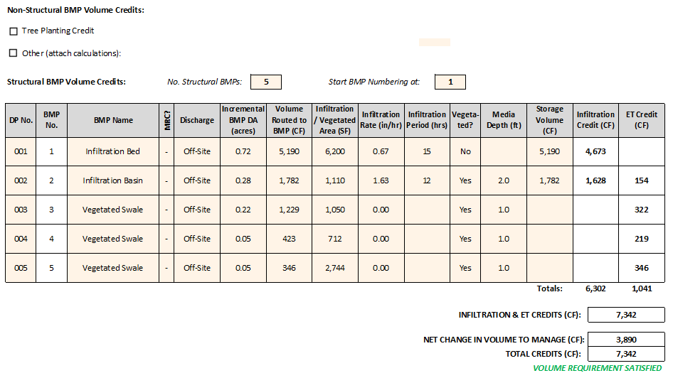
STORMWATER TREATMENT (VOLUME)
18 of 25
Notes:
The second half of the Volume Tab looks at the amount of water each facility manages. The biggest parameters that influence credits are Volume Routed to SCM, infiltration rate, and storage volume. Remember, stormwater design is an iterative process, so you are likely to not manage enough runoff on your first design attempt. The spreadsheet helps you determine which areas may need to be resized and adjusted. I find that the hardest thing is getting enough runoff to your facility before it leaves the site. This is where conveyance systems like pipes and swales become really important. When you have effectively managed enough runoff, the bottom of the spreadsheet will show the words, “Volume Requirement Satisfied.” For the example on screen, I had a surplus of credits, so my basins probably could have been sized smaller if I wanted to do so.

Slide 19
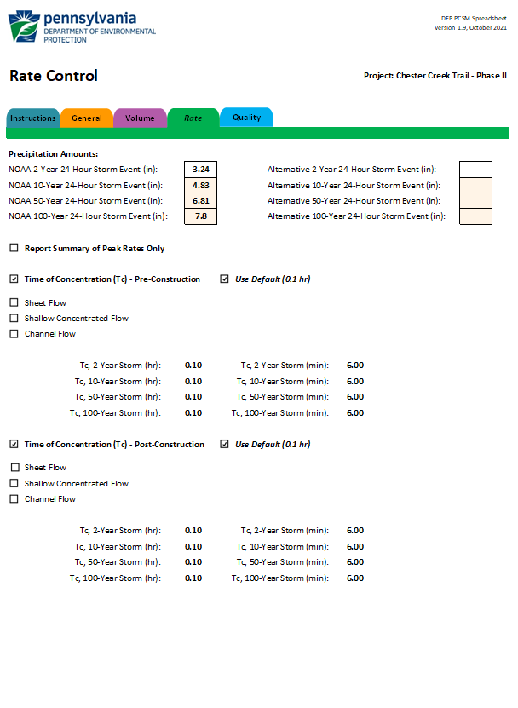
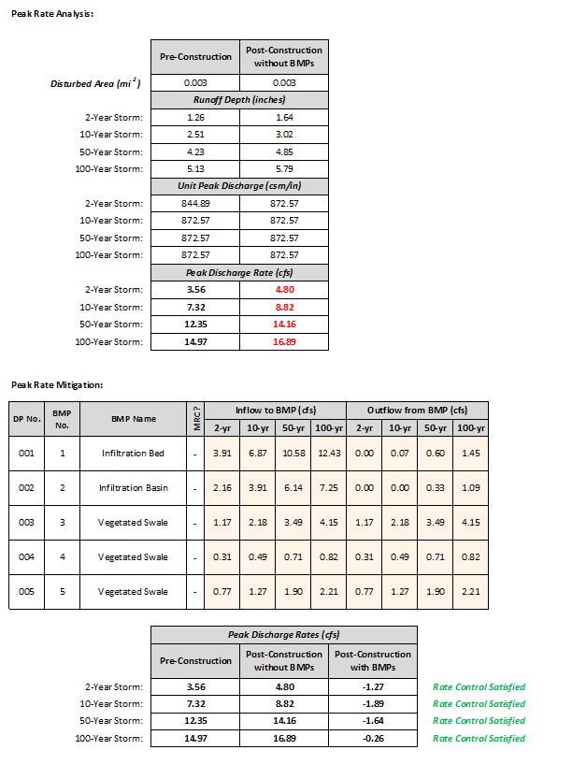
STORMWATER TREATMENT (RATE)
19 of 25
Notes:
Rate is the second category that will need to be managed. Similar to Volume, the rate at which water leaves the site in the Post-Construction condition will need to be less than that in the Pre-Construction condition. The sizing of spillways, check dams, and pipes are very crucial during this step. These mechanisms need to be balanced well to have your facility drain fully within 72 hours but not too fast where water cannot effectively be managed in your facility. DEP’s spreadsheet automatically calculates the Pre-Construction rate based on cover. The designer is responsible for determining the rate in the Post-Construction condition. Green text will show up in the bottom right corner when proper rate management has been achieved similar to that in the Volume Tab.

Slide 20
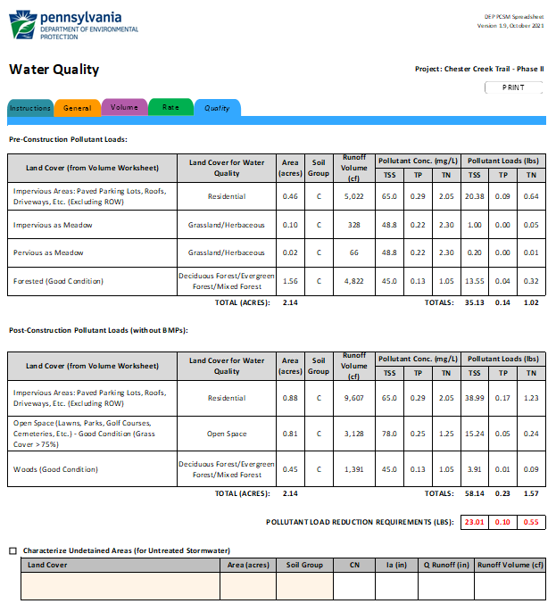
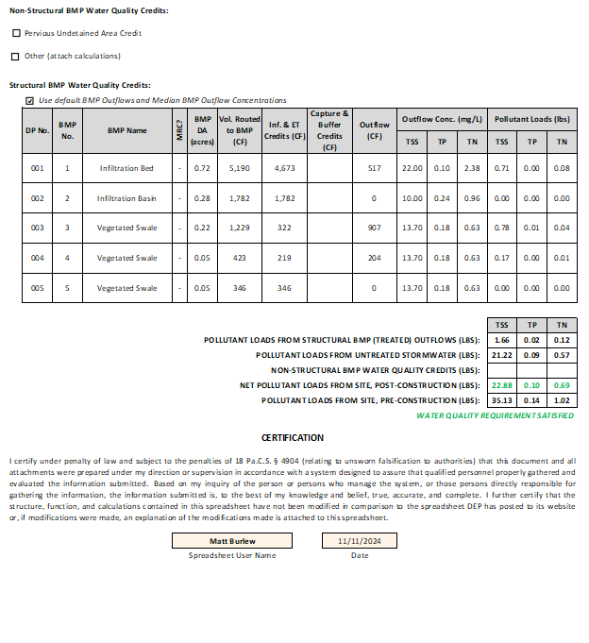
STORMWATER TREATMENT (QUALITY)
20 of 25
Notes:
The third and final category is Quality which measures the net change in pollutant loads. Unlike the first two, this section is all automatically calculated in the spreadsheet. It is a function of your facility types, volume managed and not managed by an SCM, as well as a few other factors. This category usually gives you the least amount of trouble if you managed Volume and Rate well in the previous steps.

Slide 21
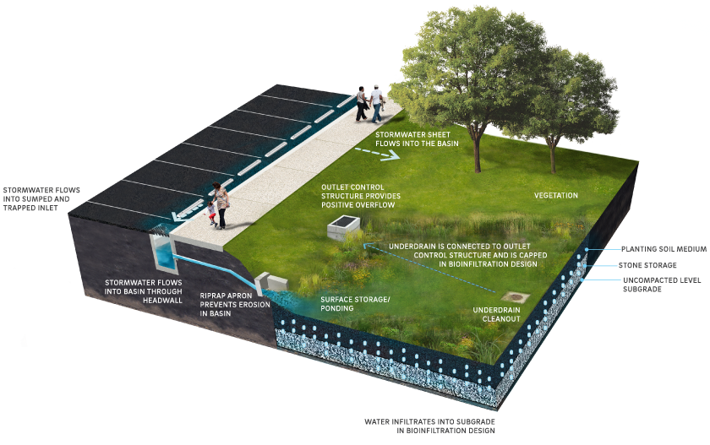
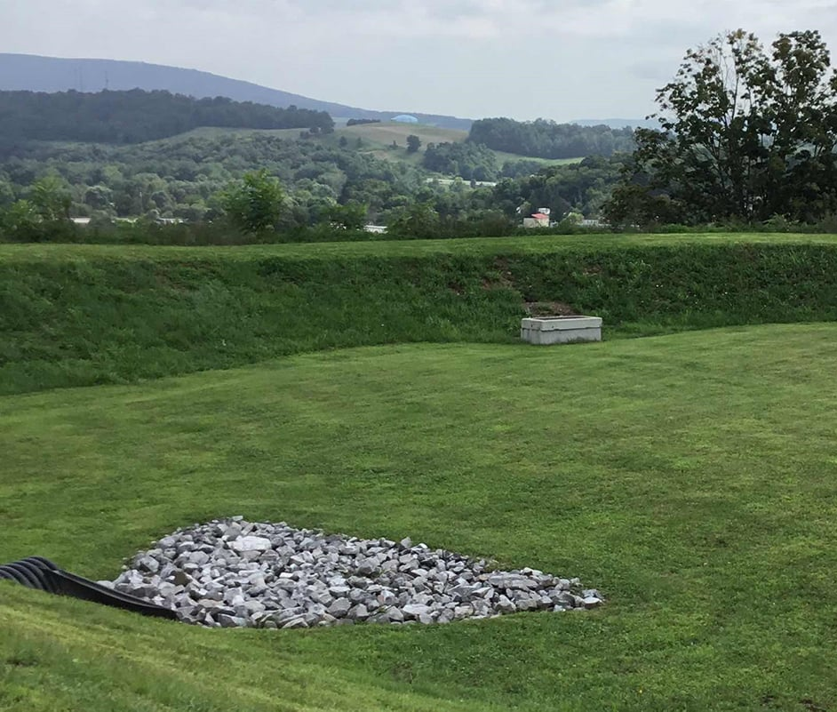
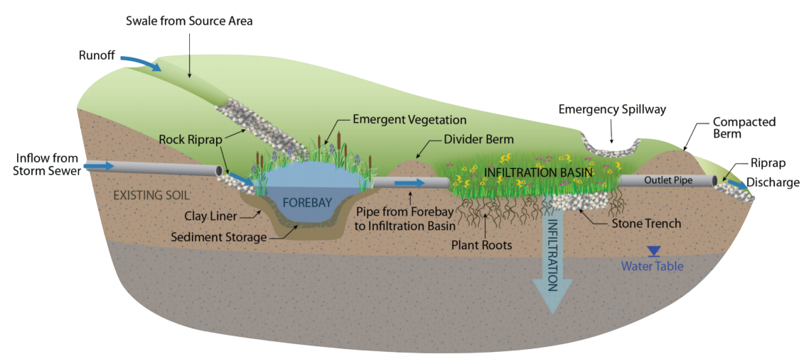
STORMWATER TREATMENT (INFIL. BASIN)
21 of 25
Volume Reduction
High
Peak Rate Control
Medium/High
Water Quality
High
Notes:
Now that I have hit on the goals of stormwater treatment design, I wanted to briefly touch on some of the various facility types you might encounter, starting first with the infiltration basin. This, to me, is the most useful, basic, and common SCM that you will find. It requires simple grading operations with a few inlet/outlet structures to operate. As runoff flows into the basin it is treated as it infiltrates through the ground below. Some of the water is also absorbed through the various plants on the basin bottom. This facility has high volume reduction and water quality capabilities with medium to high strength for rate control.

Slide 22
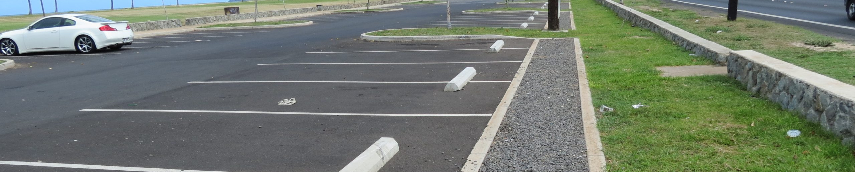
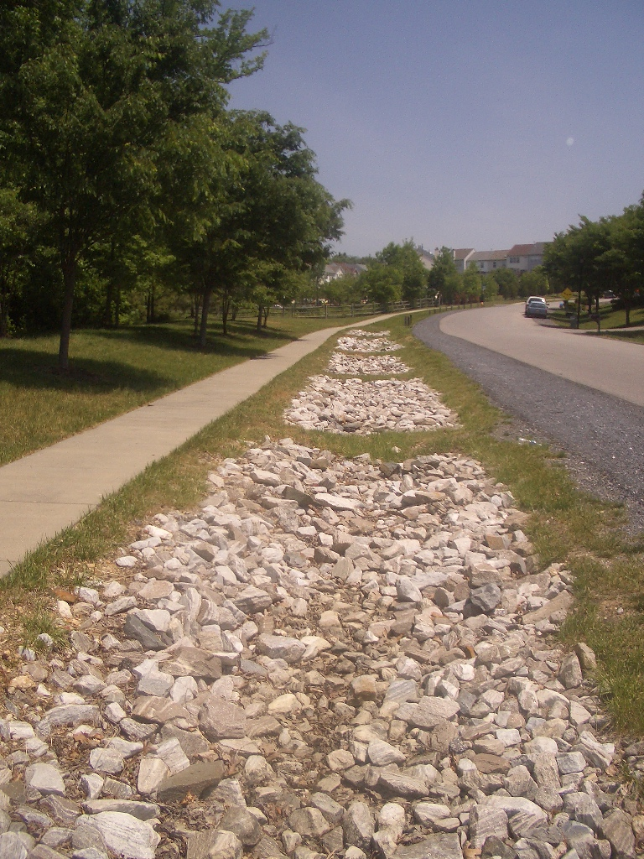
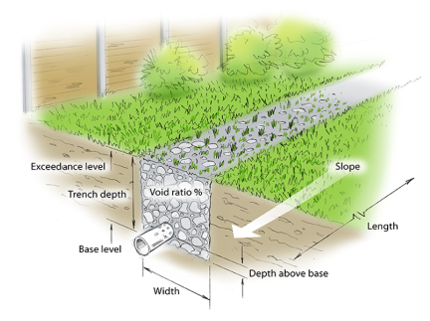
STORMWATER TREATMENT (INFIL. TRENCH)
22 of 25
Volume Reduction
Medium
Peak Rate Control
Medium
Water Quality
High
Notes:
Infiltration Trenches are relatively narrow, long, and shallow excavated strips that are generally backfilled with clean stone. Runoff is stored in the voids of the stone while it infiltrates into the earth below. Unlike infiltration basins, the infiltration trench does not generally involve pipes, inlets, or swales, bringing water into it. This SCM is placed adjacent to the impervious surface to capture runoff immediately. Infiltration trenches manage water quality quite well while reducing volume and rate relatively well.

Slide 23
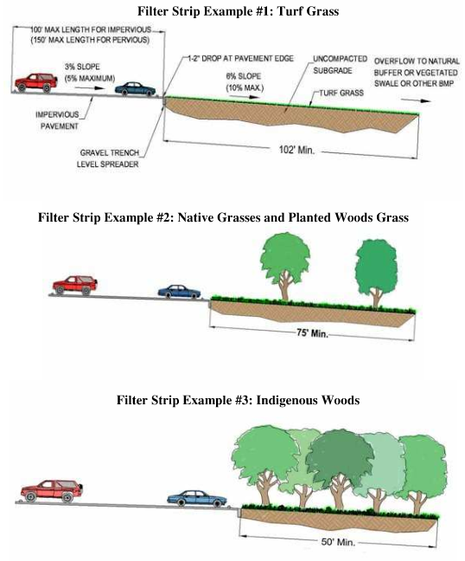
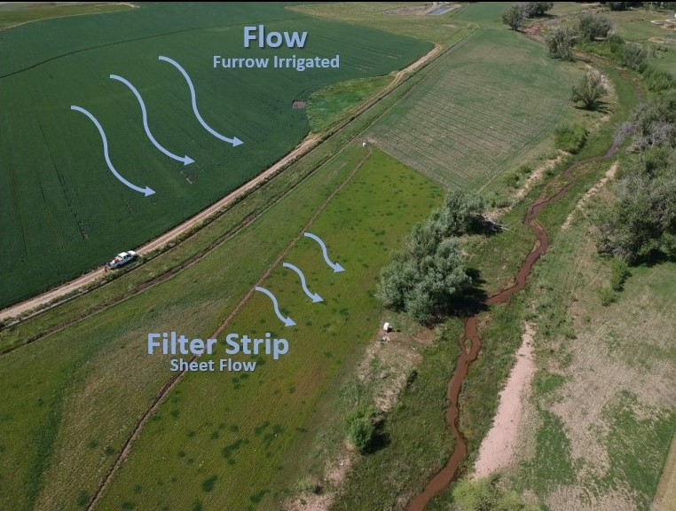
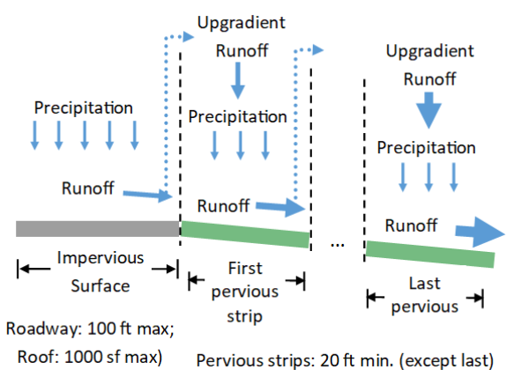
STORMWATER TREATMENT (FILTER STRIP)
23 of 25
Volume Reduction
Low/Medium
Peak Rate Control
Low
Water Quality
High
Notes:
A Vegetated Filter Strip is a permanent, maintained strip of plants and trees between a source of runoff (like a parking lot or roadway) and a receiving water (like a stream or lake). Filter strips should be long, flat, and dense with vegetation to maximize treatment. The goal is to slow water down to allow for infiltration and let the pollutants fall out. This facility's best function is water quality control while volume and rate are only managed slightly.

Slide 24
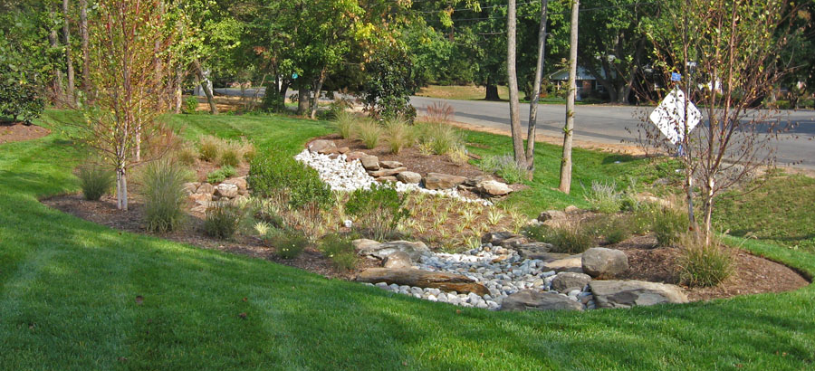
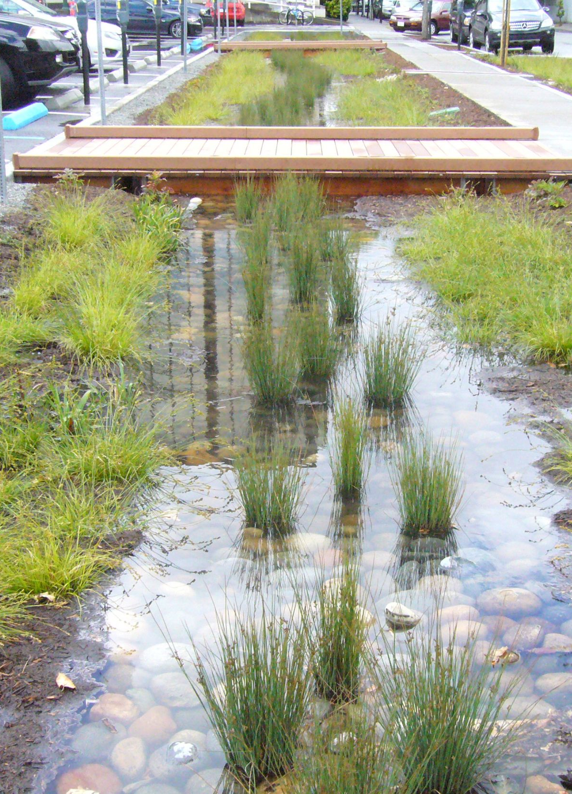
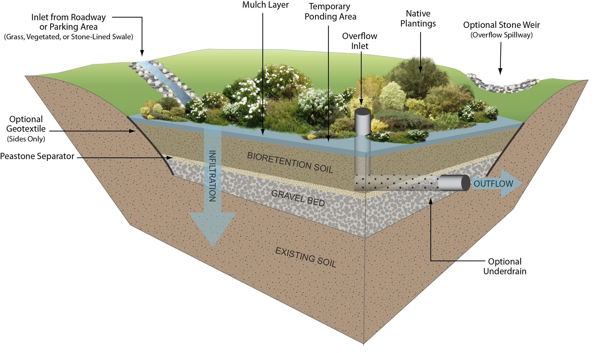

STORMWATER TREATMENT (RAIN GARDEN)
24 of 25
Volume Reduction
Medium
Peak Rate Control
Low/Medium
Water Quality
Medium/High
Notes:
Unlike the previous SCM’s, the Raingarden does not utilize infiltration to treat runoff. Instead, water is stored in the underlying gravel and bioretention soil for it to be absorbed by the variety of plants in the bottom. This by far the most complicated treatment facility and is only used when there is no infiltration capacity in the soil. In addition to requiring strict approvals from DEP, it can only be used for small drainage areas. For that reason, it is intended more for residential areas and parking lots as opposed to roadways. Volume, rate, and quality are all treated moderately well with raingardens.

Slide 25

QUESTIONS
Matt Burlew, PE
Wilson Consulting Group
MattB@WilsonEP.com
717-553-0976

Slide 26
Q&A From 1/6/2026
Who would you suggest first contacts would be regarding regulated discharges? DEP
What is the typical depth that is used for a manhole frame and cover when you are attaching it to a top slab to keep minimum depth? Is there anywhere in Pub 72 that states the height? Is there a minimum or maximum height? Refer to RC-39M. There is no minimum/maximum height
How do you select the pipe fills listed on the ECMS items? There are overlaps. Select the closest to your project. The unit prices are largely the same and the fills primarily point back to means and methods for the contractor, which they can get from the plans.
What is the height of the inlet top and minimum cover for the pipe? The inlet top is typically around 12” and there needs to be 4” from the top of pipe to bottom of inlet top. This usually aligns with a pavement section and the minimum cover over a pipe underneath pavement.

